Slide 1
Wyoming Department of Health School-Based Services (SBS) Program
Pilot Group May 2023 Meeting

Slide 2
Agenda
SBS Program Updates
Program Resources
Claims Data
Remittance Advice
Open Discussion

Slide 3
SBS Program Updates

Slide 4
Updates from WDH and WDE
1
Claims Submitted
2
Remittance Advice
Updates
3
Counseling CPT Code Follow Up
4
Engagement for Summer Months

Slide 5
SBS Program Resources

Slide 6
Website Resources
Assess
Parental Consent
National Provider
Identifier
Medicaid Provider
Enrollment
Billing and
Documentation
Landing Page
Intro to SBS
SBS Fact Sheet
Provider Manual
Contact Information
Link to Help Desk
Parental Consent Checklist
Parental Consent Form*
Parental Consent Memo - LEAs
Parental Consent FAQ – Parents*
*Spanish version are also available and posted.
Link to apply for an NPI
NPI Memo
NPI Directions
NPI Application
Guidance on Choosing Taxonomy
Directions on hoe to enroll as a provider
Guidance on Choosing Taxonomy
Guidance on Enrolling in PRESM
WY SBS Provider Manual
Documentation Requirements Checklist
Guidance on:
- Medical Necessity
- Documentation
Requirements
- Provider
Taxonomy
- Diagnosis Codes
- SLP Services

Slide 7
Website Resources
Newsletter and
Trainings
WDE Memos, Rules,
And Links
SPA, Admin Rules,
Legislation
Provider Cheat
Sheets
Assess
Quick Links
Past WY SBS Program newsletters
Past WY SBS Program training PowerPoints
WDE Rules Chapters 7 & 44
WDE Memos on Medicaid Eligibility Data Reporting
WDE Website
WDE Special Education Page
WDE IDEA and SpEd Resources
SBS Legislation SF0079
SBS Approved State Plan Amendment
SBS Approved Admin Rules
SBS Legislative Report 2021 & 2022
Psychology and Counseling Services
Speech, Language and Hearing
Occupational Therapy Services
Physical Therapy Services
Nursing Services
SBS Fact Sheet
WY SBS Manual
Guidance Documents
NPI Directions & Application
Parental Consent Checklist, Form, and FAQ sheet

Slide 8
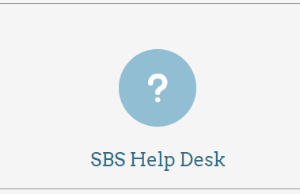
Website Resources – SBS Help Desk
Who: Anyone (LEAs, providers, parents, etc.)
What: A place to ask questions and get information
When: Available anytime
Where: The bottom of the WY SBS Program website
Why: To provide support and technical assistance

Slide 9
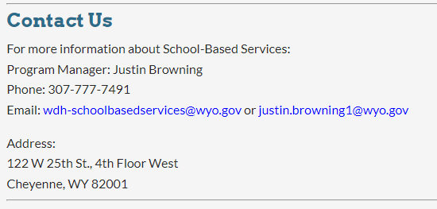
Website Resources – Contacts

Slide 10
Claims Data

Slide 11
Converse County School District 1 Submitted Claims as of May 12, 2023
706 Paid Claims
405 School Counselor
144 Speech-Language Pathologist
157 Professional Counselor
$35.5k
Reimbursed by Medicaid

Slide 12
Remittance Advice

Slide 13
Remittance Advice Overview
A Remittance Advice (RA) is proof of payment and explains the outcome of claims submitted for payment.
1 | When RAs are Available After claims have been processed weekly, RA are generated for each billing provider.
2 | Where RAs are Available WDH posts an RA to the Provider Portal that each provider can retrieve and download. In addition, most billing vendors have them available for you to access. RAs are also available in SpedAdvantage.
3 | Why RAs are Important The RA plays an important communication role between Providers and Medicaid. It explains the outcome of claims submitted for payment. Aside from providing a record of transactions, the RA assists providers in resolving potential errors. LEAs can use the RAs to help track payments received for accounting and documentation purposes.

Slide 14
Remittance Advice Organization
Cover Page
The first page is important and provides a summary.
Summary Page
The second page provides a summary of paid, denied, credited, gross adjusted, total billed, and total paid.
Detail Pages
The next pages are the claim detail pages which list the Members information, rendering NPIs, dates of services, procedure codes, modifiers, quantity, billed amount, (Medicaid) approved amounts, TPL amounts, category, and reason and remark codes.
Glossary Pages
The last pages list the Error Code details with associated Claim Adjustment Reason Codes and Remittance Advice Remark Codes for the denied lines and claims.

Slide 15
Sample Cover Page
Cover Page Field Name | Notes
Billing Provider ID | Billing Medicaid Number
Billing Provider NPI | Billing National Provider Identification Number
Name | Name of Billing Provider
Pay Cycle | Pay cycle for the Remittance Advice Report established according to the Remittance Advice Schedule
RA Number | Remittance Advice Identification Number (system generated for each Billing Provider).
RA Date | Date the Remittance Advice was created

Slide 16
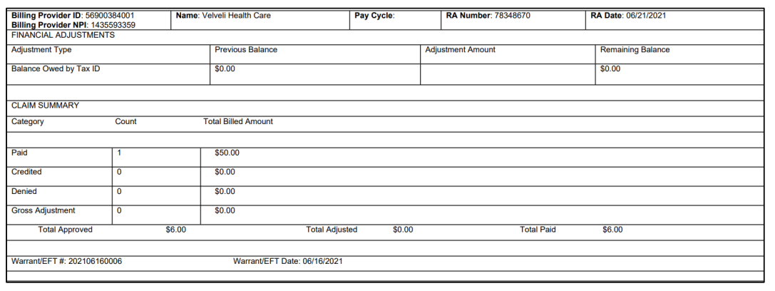
Sample Summary Page

Slide 17
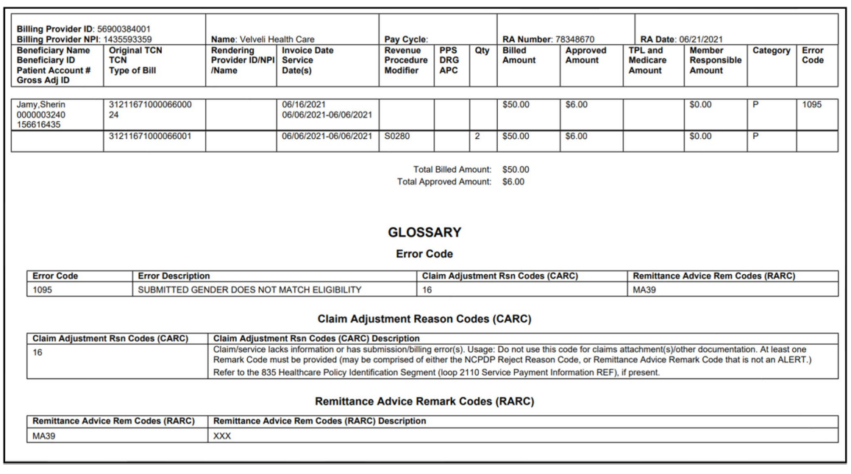
Example Detail Pages

Slide 18
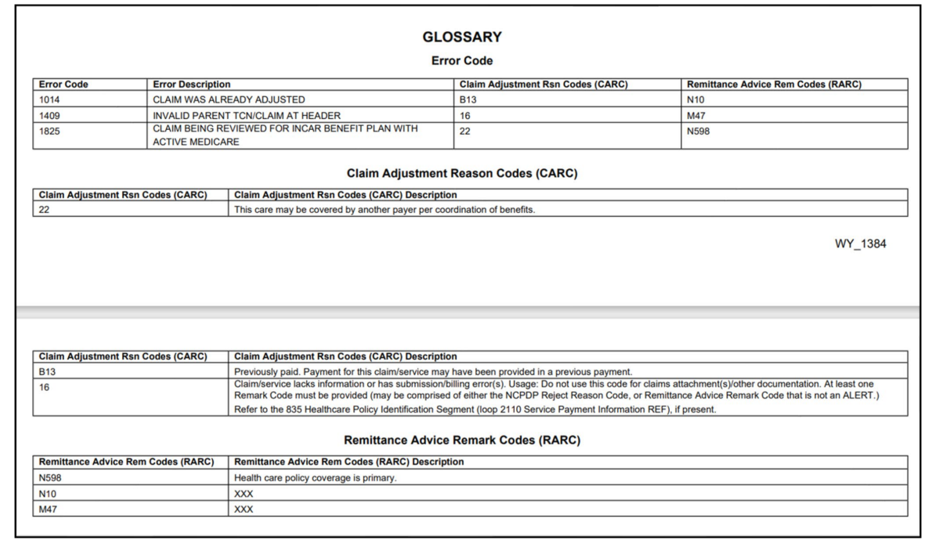
Glossary Pages

Slide 19
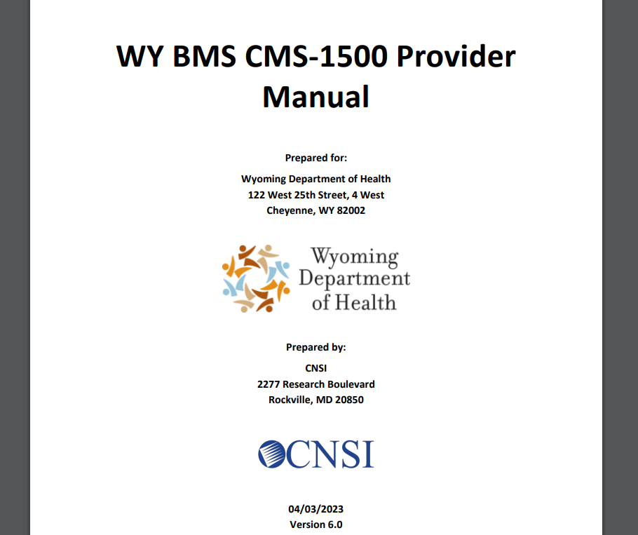
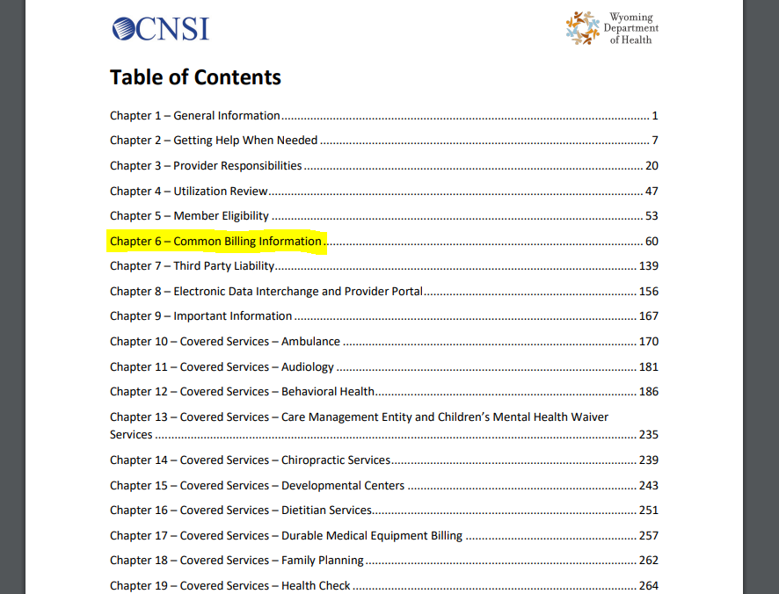
Where to Find More Information
The WDH Medicaid Provider Manual – “CMS 1500 Provider Manual”
https://www.wyomingmedicaid.com/portal/Provider-Manuals-and-Bulletins/CMS-1500-Provider-Manual

Slide 20
Open Discussion/ Q&A

Slide 21
Questions & Resources
WY SBS Program Contacts:
Justin Browning, WDH, SBS Program Manager
justin.browning1@wyo.gov
Trent Carroll, WDE, Chief Operations Officer
Shelley Hamel, WDE, Chief Academic Officer
WYSBS@guidehouse.com
https://health.wyo.gov/healthcarefin/medicaid/school-based-services/
Wyoming School-Based Services Website Includes Resources Such As:
Provider Manual
Training Documents

