Slide 1
WBCCEDP &
Wyoming Colorectal
Cancer Screening Programs
February 2023
Colorectal Cancer Awareness Month in March

Slide 2
General Updates
Continue to submit claims with attachments before 30 day suspension is over to avoid claims being denied and needing to be resubmitted.
We have established a monthly series of topics to cover month to month with the same event link
We welcome conversations on other pertinent topics at the end of each session on anything you want to know with the whole WCP team present.

Slide 3
Colorectal Cancer Awareness Month - March
Colorectal Program changes are underway and will be announced soon
Current program rules are 50+, 250% of FPL, level of symptoms vs. prior history dictate the frequency of screening
Finding cancer early, when it's small and hasn't spread, often allows for more treatment options
Colorectal Cancer Alliance
Colon Cancer Coalition Website
1 in 24 people develop colon cancer
Notes:
Tanya

Slide 4
Colorectal Cancer Alliance

Slide 5
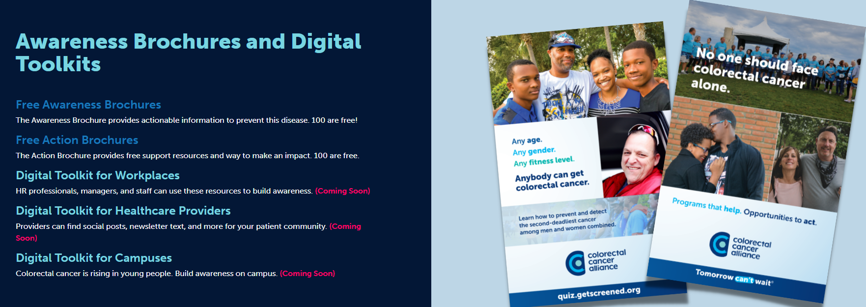
Colorectal Cancer Awareness Month - March

Slide 6
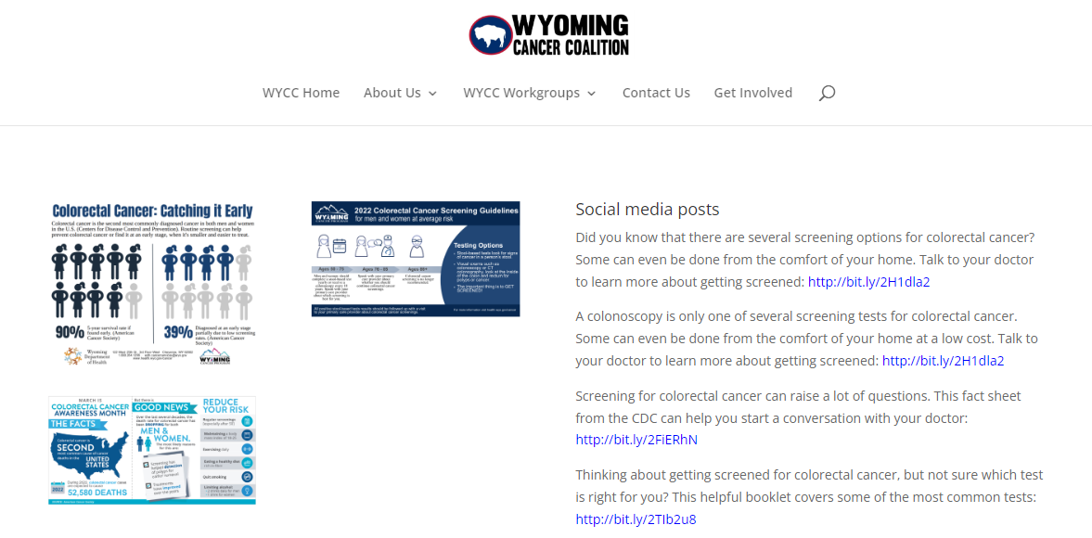
WYCC - Colorectal Awareness Resources

Slide 7
GW Uni - Campaign Materials

Slide 8
Colon Healthy Recipes
Eat plenty of fiber
Avoid eating processed meat like Deli Ham, Sausages, Jerky etc
Eat Chicken, Fish, Turkey, Legumes, Nuts & Seeds
Moderate alcohol consumption
Eat fruits and avoid fruit juice
Great website to get Healthy recipes
EatingWell.com
No 2 in cancer related deaths
Notes:
Tanya

Slide 9
80% Screening Pledge
Individual providers can sign up for the colorectal screening pledge to get 80% of clients to screenings (broader than just the WCCSP)
National Colorectal Cancer Roundtable - Take the 80% Pledge here at the NCCRT website
Current Pledges include: Cheyenne Regional Medical Center, Heptner Cancer Center Campbell County Health, Memorial Hospital of Sweetwater County, St. John’s Medical Center, Summit Medical Center, Wyoming Cancer Resource Services
Notes:
Tanya

Slide 10
Sign Up to Receive Notifications
The WCP will send out programmatic updates via email
Sign up on our website or by completing this form
The Wyoming Cancer Coalition monthly newsletter
Sign up here to receive WYCC news

Slide 11
March Provider Listening Session
Please join the WCP for our provider updates and listening session in March. This is a chance to ask questions on claims, what is covered, how payments are made, and any other questions on WCP processes and procedures during a live session.
WCP Screening Program Updates & Listening Session - March 2023
Tuesday, March 21 · 10:30 – 11:30am
Google Meet joining info: Video Call Link
Or dial: ‪(US) +1 267-393-4324‬ PIN: ‪467 030 417‬#
More phone numbers
Prior Sessions: Please visit the WCP website to find prior training, listening sessions, and slides for viewing/downloading

Slide 12
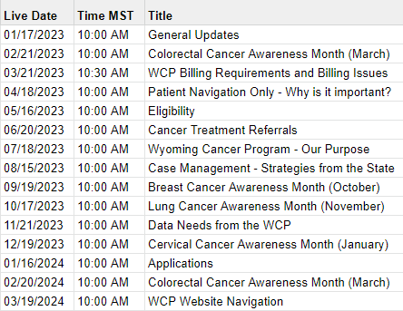
Schedule of Topics
Meeting Link

Slide 13
Unit Manager: Star Jones
Screening Program Supervisor: Mark Kelly
Data & Billing Manager: Megan Westphal
Program Nurses: Val Knepp & Tanya Riekens
Enrollment Specialist: Nicole Motter
1-800-264-1296
wdh.cancerservices@wyo.gov
health.wyo.gov/cancer

