Slide 1
Wyoming School-Based Services (SBS)

Slide 2
Agenda
Overview of School-Based Medicaid Services
Wyoming School-Based Medicaid Services
Implementation Plan & Timeline
SBS Program Benefits
School District Roles, Responsibilities & Materials
Stakeholder Engagement Groups
Questions & Resources

Slide 3
Overview of School-Based Medicaid

Slide 4
Overview of School-Based Medicaid Definition & History
School-Based Medicaid is a federal program that reimburses local education agencies (LEAs) for providing direct health services to Medicaid students in a school setting
LEAs may include local school districts or charter schools
Allows schools to submit claims to Medicaid for the costs of services provided to Medicaid eligible students
Currently, all states, except Wyoming, authorized school-based health services in some capacity, to be billed to Medicaid
Estimated Federal Medicaid spending on school-based services in FY2016 was $3.3 billion
1998: Medicaid began providing reimbursement for some school-based services
2014: Medicaid expanded services covered for Medicaid eligible students
2021: Wyoming Legislature passed the Medicaid Billing for School-Based Services Act which authorizes school districts to bill for some school-based services for Medicaid eligible students

Slide 5
Overview of School-Based Medicaid Program Requirements
Services can be eligible for Medicaid reimbursement if the following requirements are met:
Student is eligible for Medicaid
Parental consent is provided
Services are included in the state plan or are available under Early Period Screening, Diagnosis, and Treatment (EPSDT)
Services are medically necessary
Third party liability (TPL) requirements are met
Federal and state regulations are followed (including provider certification)
Schools can bill Medicaid for:
Eligible medical and health related services for Medicaid eligible students
Services can include: physical therapy, occupational and speech therapy, psychological counseling, nursing, and specialized transportation services
Student is enrolled in an Individualized Education Program (IEP) or Individualized Family Service (IFSP)

Slide 6
Wyoming School-Based Medicaid Services

Slide 7
Wyoming School-Based Medicaid Services
State Plan Amendment, which was approved by CMS on 7/19/22, includes the following as eligible for Medicaid reimbursement:
Service | Provider
Speech Language Therapy | Speech Language Pathologists
Nursing | Registered Nurses, Advanced Practiced Registered Nurse, Licensed Practical Nurses, Licensed Vocational Nurses, & Certified Nurse Assistants
Occupational Therapy | Occupational Therapists, Occupational Therapy Assistants
Physical Therapy | Physical Therapists, Physical Therapy Aides / Assistants
Psychology/ Counseling (School) | School Psychologists
Psychology/ Counseling (School) | School Social Workers
Psychology/ Counseling (School) | School Counselors
Psychology/ Counseling (School) | Certified Mental Health Workers (CMHW)
 | Marriage and Family Therapists
Other health care services delivered in school settings will continue to be delivered but are not eligible for Medicaid reimbursement. Wyoming Medicaid does not determine what other services a school district may offer.

Slide 8
Implementation Plan & Timeline
Submitted – Fall 2021
Submitted – Fall 2021
Ongoing – Fall 2021 through Spring 2022
In Progress – Winter 2021 through Spring 2022
In Progress – April – June 2022
Legislative Report:
Report to legislature indicates the implementation activities and pending actions by state entities / Departments
State Plan Amendment:
Medicaid amendment for implementation of School-Based Services, including identification of services eligible for reimbursement. CMS approved the SPA on 7/19/22.
Stakeholder Engagement:
Ongoing process engaging all levels of stakeholders, discussing implementation and soliciting feedback, including advisory and pilot groups
Fiscal Intermediary Implementation of SBS Reimbursement:
Identified participating school districts
Provide school district support to ensure technical systems can collect SBS information and initiate billing service
Provider Training and Program Implementation:
School district training on program and processes and available resources to districts who plan to participate in the first year

Slide 9
SBS Program Benefits

Slide 10
Benefits of School-Based Services Program Funding
Allows school districts to bill Medicaid for school-based services
Potential for State cost savings by claiming federal match on allowed services
Enables the state to repurpose state and local funds to the School Foundation Program Account
Funds are delivered to all schools / districts based on allowable services provided to students

Slide 11
Flow of Funds and Reimbursement
Care is delivered to beneficiaries in the school setting. State pays for allowable services when provided by a Wyoming Medicaid Provider.
Districts provide documentation of services delivered
Claims gets sent to Wyoming Medicaid for Reimbursement*
Wyoming Medicaid reimburses School Districts for services delivered and School Districts remit funds to the Department of Education School Foundation Program Account
*Documentation process will not change for districts

Slide 12
Benefits of School-Based Services School Practices Won’t Change
Schools will deliver the same services to students
Schools’ responsibility will continue to be the maintenance of care delivery
With integration of the districts billing systems, districts should have a streamlined billing process
Parent/student involvement is only required through the parental consent form and through the IEP/IFSP
Delivery of services will not be disrupted

Slide 13
School District Roles, Responsibilities & Materials

Slide 14
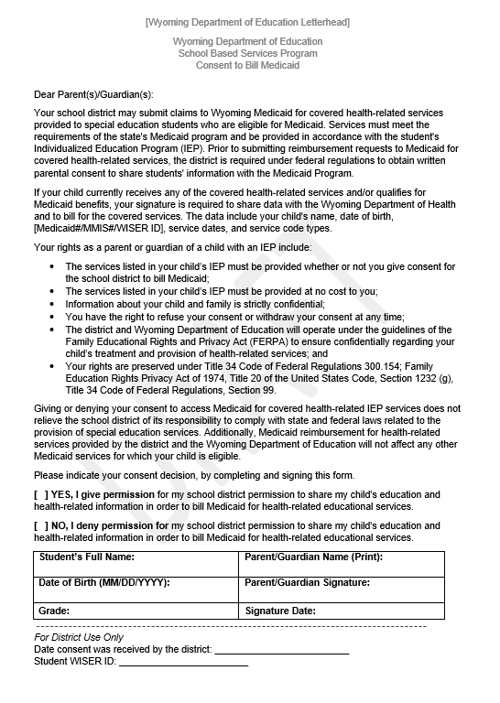
School District Roles & Responsibilities Parental Consent Form
LEAs are responsible for distributing and collecting Parental Consent Forms
Forms are to be stored within LEA:
Some billing vendors used by districts have a field in their system to notate that a signed parental concert form is on file
Form should follow student
Communication and follow-up with parents
FAQ and Stakeholder Engagement
If parents opt out of program, students will still receive care, but districts cannot bill Medicaid for the services
Notes:
Have copy of consent form ready

Slide 15
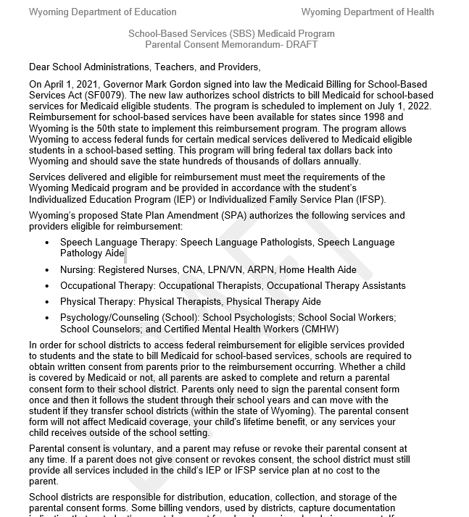
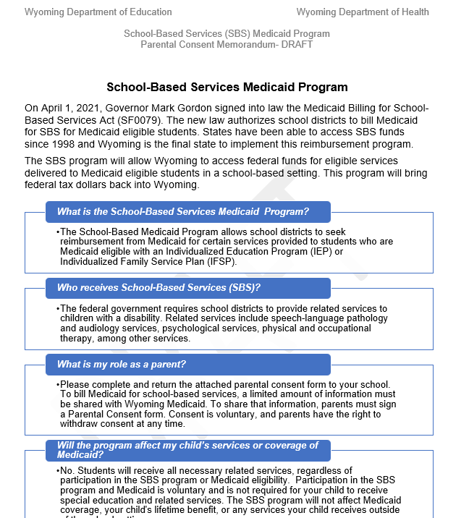
Stakeholder Materials – Parental Consent Form Memo & One-Pager
Parental Consent documents include:
Memo (Administrators)
One-Pager (Parents)
Parental Consent Form
Distribution/Access:
Posted on SBS Website: https://health.wyo.gov/healthcarefin/medicaid/school-based-services/
Share with Districts
Parental Consent Memo
Parental Consent One-Pager

Slide 16
School District Roles & Responsibilities Billing
Billing system needs to be able to keep information on beneficiaries, parental consent, and document services delivered
LEAs can partner with vendors for billing functionality to submit Medicaid claims
LEAs will coordinate delivery of the services
LEAs must document delivery of services
All documentation must be available for federal audit and/or state review
WDH and WDE will work with districts and vendors to support a seamless transition to Medicaid billing

Slide 17
School District Roles & Responsibilities School Information Systems - Documentation
Districts will use current school information systems to track students Medicaid eligibility and keep appropriate documentation
Districts can utilize the benefit management system to verify Medicaid eligibility
All students who receive Medicaid services must have:
A documented IEP or IFSP describing need for services
Signed Parental Consent
WDH and WDE will work with districts and vendors to support school Medicaid documentation procedures

Slide 18
School District Roles & Responsibilities Qualified Providers and National Provider Identifiers
Districts must ensure that providers have appropriate qualifications to deliver Medicaid services
State Plan Amendment indicates services and providers eligible for reimbursement
Districts must ensure school-based services are delivered by providers with an NPI
Qualified Providers
National Provider Identifier (NPI)
NPIs are required by Medicaid for all providers that bill services
To continue to deliver services, some current providers may need to apply for an NPI
National Provider Identifier (NPI) Application: NPI Application

Slide 19
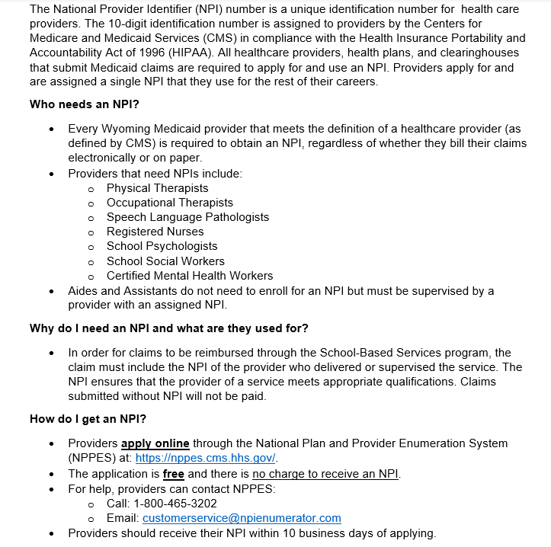
Stakeholder Materials – NPI Document
Document includes detail on NPIs, how to obtain an NPI, and who needs an NPI
NPI document available on WY SBS website: https://health.wyo.gov/healthcarefin/medicaid/school-based-services/
NPI Document: Example

Slide 20
Stakeholder Engagement Groups

Slide 21
Stakeholder Groups: Advisory & Pilot
Advisory Group
Pilot Group
Group of representatives made up Department of Education, Department of Health, School Districts, Providers, and other Stakeholders.
Group meets monthly to discuss SBS development and implementation, including processes and materials, and to discuss updates related to SBS.
WDH gathers feedback from the group to make updates, provide clarity, and support SBS implementation.
Representatives from 5 districts piloting WY School-Based Services
School Districts indicated that they joined the pilot group to get ahead of the requirements of SBS and work through program kinks and challenges.
Group helps identify and discuss areas of concerns and opportunities for WDH to support districts in the implementation process.

Slide 22
Questions & Resources

Slide 23
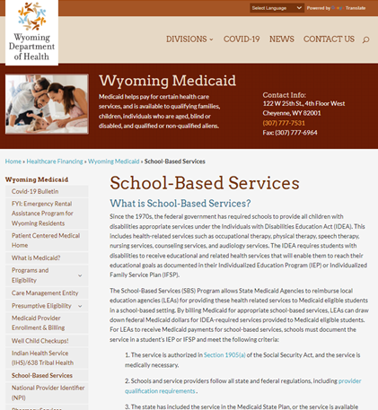
Questions & Resources
https://health.wyo.gov/healthcarefin/medicaid/school-based-services/
Wyoming School-Based Services Website Includes Ressources Such As:
Provider Manual
Training Documents
Contacts:
Justin Browning, WDH, SBS Program Manager
justin.browning1@wyo.gov
Trent Carroll, WDE, Chief Operations Officer
Shelley Hamel, WDE, Chief Academic Officer
WYSBS@guidehouse.com

