Slide 1
AIM Safety Bundle Implementation – UT/WY Partnership
Laurie Baksh, MPH
Utah Department of Health

Slide 2
Alliance for Innovation on Maternal Health - AIM
AIM Purpose:
“To equip, empower and embolden every state, perinatal quality collaborative, hospital network system, birth facility and maternity care provider in the U.S. to significantly reduce severe maternal morbidity and maternal mortality through proven implementation of consistent maternity care practices.”

Slide 3
Patient Safety Bundles
Developed by the Council on Patient Safety in Maternal Health
A patient safety bundle is a set of straightforward, evidence-based recommendations for practice and care processes known to improve outcomes

Slide 4
Patient Safety Bundles
Each bundle addresses four domains:
  Readiness
  Recognition and prevention
  Response
  Reporting and systems learning
Goal is to create a system of safety and quality

Slide 5
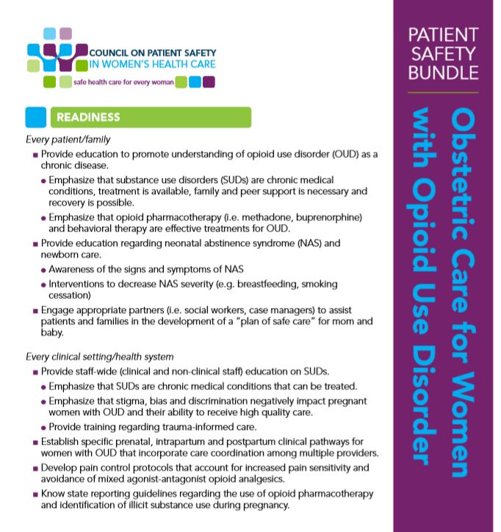

Slide 6
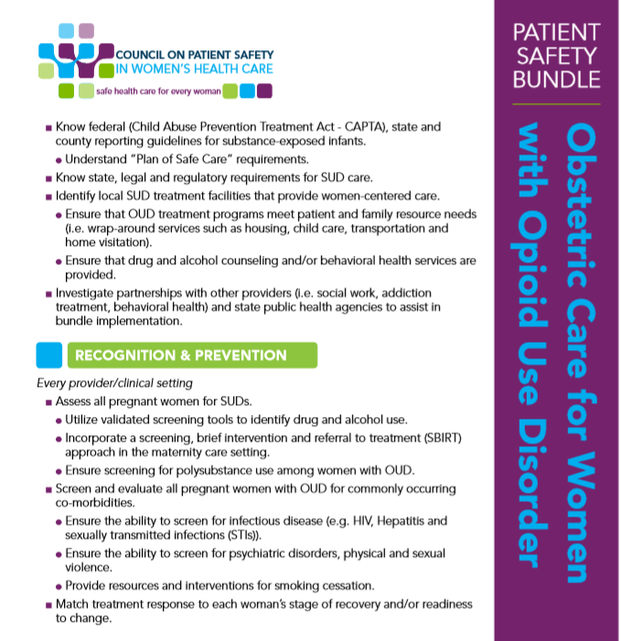

Slide 7
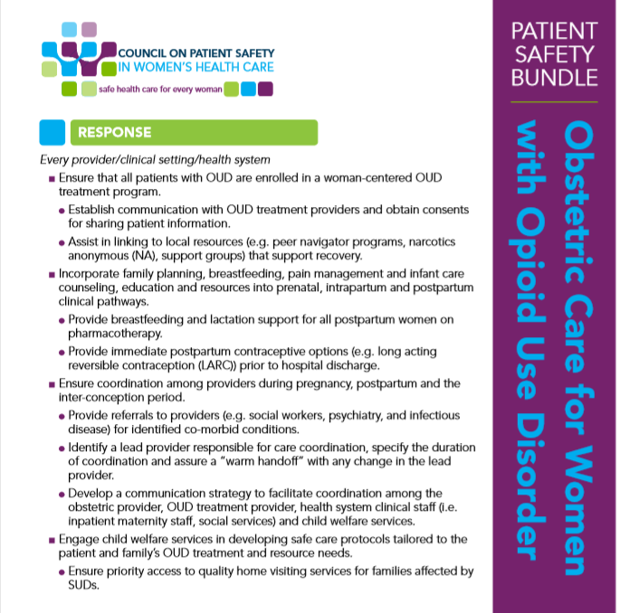

Slide 8


Slide 9
AIM Data Portal
Data measures to allow tracking of progress
Hospitals can compare to other de-identified facilities statewide (and soon, nationally)
Reporting outcome measures, process measures, structure measures

Slide 10
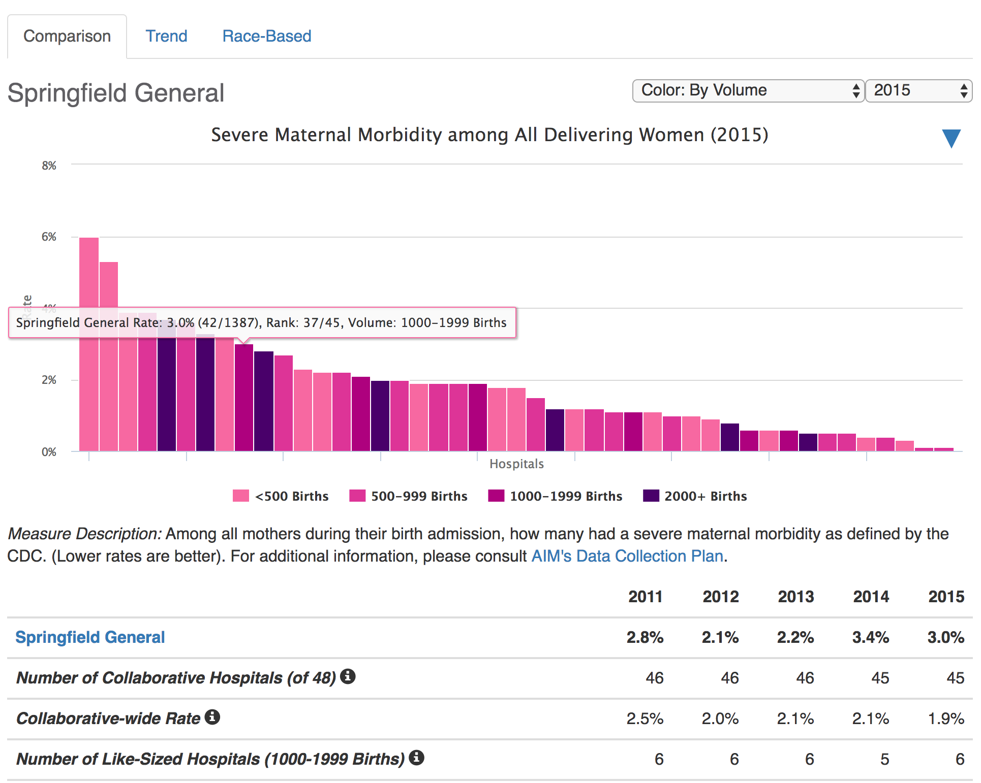
Measure Comparison
Bar per hospital; your hospital is flagged. Can customize coloring, time period, download

Slide 11
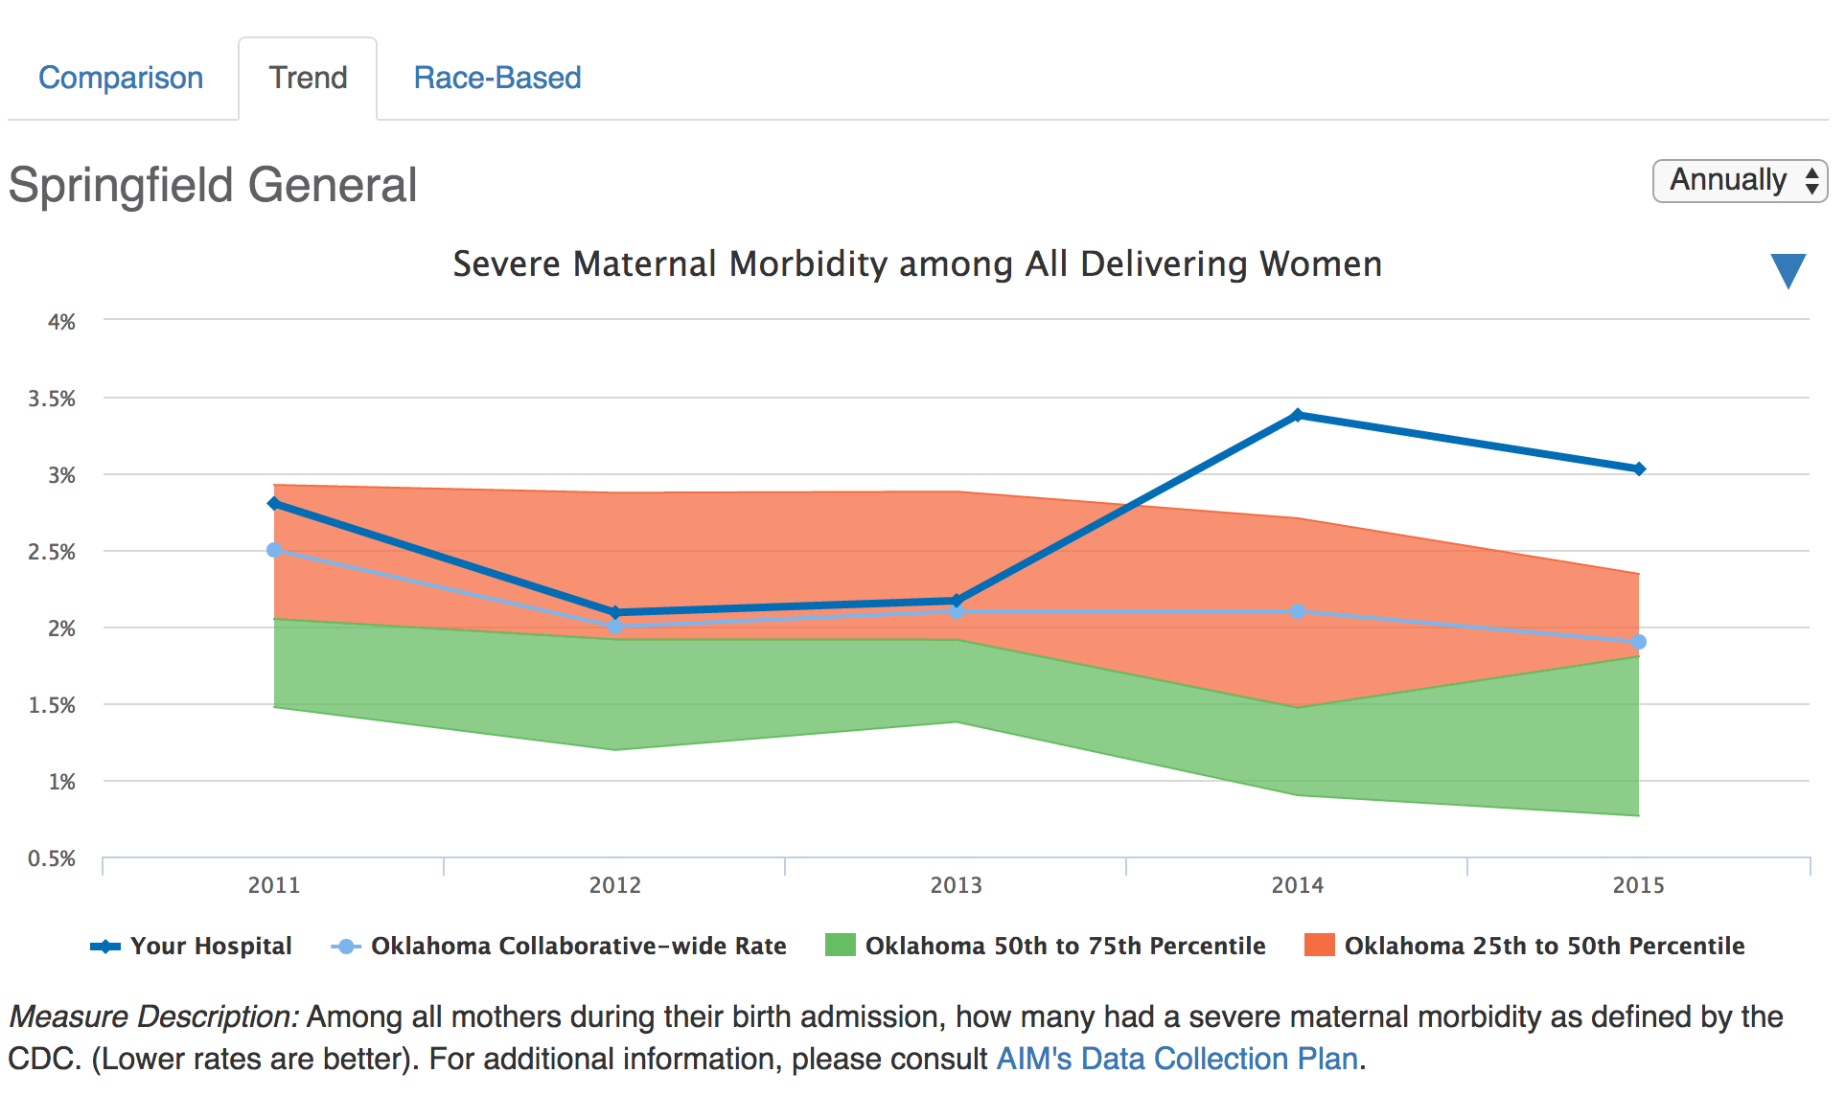
Measure Trend
Trend for your hospital, collaborative. Can customize frequency, download

Slide 12
AIM Process in Utah
For each safety bundle:
  In person launch meeting
    Set goals, team building, subject matter presentations
  Learning sessions conducted via Project ECHO
    Sessions are taped and put on an unlisted YouTube channel for future viewing
  Final in person meeting
  Bi-monthly “touch base” sessions
  Data submissions

Slide 13
Project echo
Project ECHO (Extension for Community Healthcare Outcomes) aims to amplify health care provider capacity to provide best practice care in rural and underserved areas through the use of technology
Utah’s team utilizes this technology to deliver education on the components of the AIM safety bundles through expert presentations on individual components followed by interactive time to discuss strategies for implementation and overcoming challenges
Facilitates the building of a community of practice

Slide 14
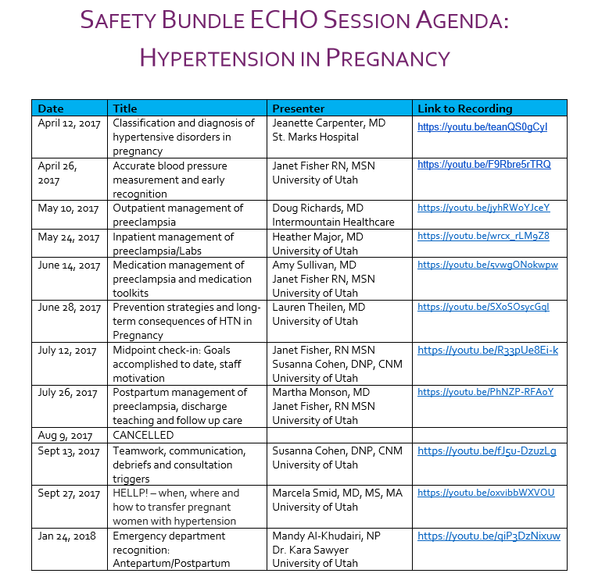

Slide 15
Hospital Recognition
AIM working on criteria for a hospital recognition program- more details to follow.

Slide 16
Questions?
Lbaksh@Utah.gov

