Slide 1
Wyoming Quit Tobacco Program
How do I talk about it and how do I refer patients?

Slide 2
Quitline
Quitlines help people quit using tobacco.
The Quitline works:
31% Quit rate NRT+Counseling
44% Quit rate Chantix+Counseling
Convenient cessation counseling
Medications provided at no cost – sent directly to patient
Serves individuals at their time of need – quitting is often impulsive
Contracted through National Jewish Health – top respiratory hospital in the nation.

Slide 3
What is it?
A comprehensive program based on the latest in evidence-based cessation treatment services.
Includes:
Coaching Program – 5 coaching Sessions (usually 1-2 weeks apart) by telephone
Motivational Interviewing
FREE Nicotine Replacement Therapy+ Quit Meds
12 weeks of patches/gum/lozenges
Combination therapy for heavy users
Chantix at no cost (3 months) – with prescription
Wellbutrin at no cost (3 months) – with prescription
Materials sent via mail/email
24/7 online program available QUITWYO.ORG
Text support and apps

Slide 4
Recent Updates
Shortened intake process
Resulted in more conversions from intake to first coaching call
Increased number of coaching calls completed
May enroll again after 90 day wait period and still receive NRT
Previously only able to receive NRT once in a calendar year from date of first enrollment, but could still participate in coaching
Behavioral health pilot study

Slide 5
Pregnancy Protocol
Incentivized Program
$5 Visa pre-paid card per call while pregnant, up to $25
$10 Visa pre-paid card per call postpartum, up to $40
One on One Coaching Relationship
Female coach
Postpartum coaching and support
MUST be pregnant at time of enrollment– verified by provider
NRT/Quit meds available (MUST be approved by physician)

Slide 6
Tailored program specifically for the American Indian population
Program offers similar medication options
More counseling sessions which tend to be shorter
Native cessation coaches
Respects traditional/ceremonial tobacco use
Differentiates ceremonial tobacco from addictive and harmful commercial tobacco

Slide 7
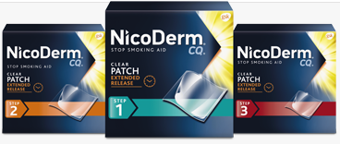
Nicotine Replacement therapy - patch
24 hour patch
3 steps (21mg, 14mg, 7mg)
1 patch per day, not recommended to smoke on the patch
Can be used in conjunction with gum, lozenge, bupropion

Slide 8
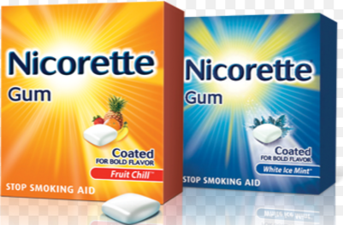
Nicotine replacement therapy - gum
2mg and 4mg gum available
Recommended to use on a schedule, not as needed
Slow chew, then tuck in between cheek and gum
Some people can get addicted

Slide 9
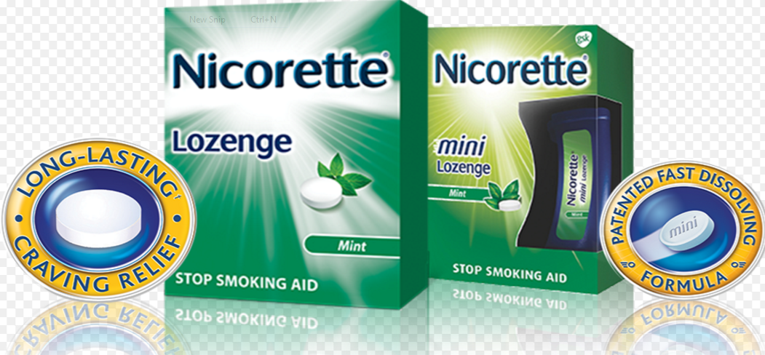
Nicotine replacement therapy - lozenge
2mg and 4mg available
Ideal for people who have dentures
Use on a schedule
Tuck between cheek and gum
Addiction possible

Slide 10
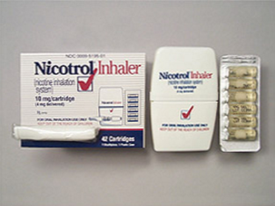
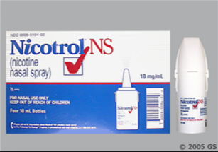
Nicotine replacement therapy - other
Nasal spray and Inhaler – both require prescription
Not offered through the WQTP

Slide 11
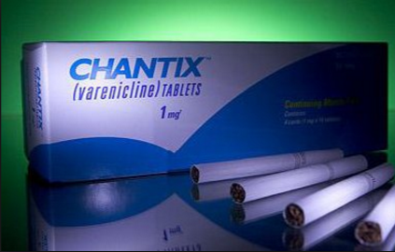
Other prescription Medications
Notes:
You can use wellbutrin with NRT medications, but Chantix – being a nicotine receptor blocker – is obviously not used with nicotine therapies.

Slide 12
Fax Referral - Patient
Notes:
Paper referrals are on their way out, hopefully, but if a paper referral is needed, make sure that the patient’s name, phone number, and consent to be contacted is included. Quitwyo.org also has online referrals that may be more convenient.

Slide 13
What Can You do?
Advocate for the WQTP in your communities
Maintain a stock of brochures
Visit healthcare providers
Larger businesses may have wellness programs
Request any of the QUIT IT! and YOU CAN! media assets to run on your local stations
Activities for Great American Smokeout and World No Tobacco Day

Slide 14
Contact Info
Feel free to contact me for WQTP questions, referral forms/brochures
Hannah Eck
Office: 307.777.6541 or
Email: hannah.eck@wyo.gov

