Slide 1
MDRO Containment Strategy and Tabletop Exercise
Cody Loveland, MPH
Wyoming Department of Health

Slide 2
Outline
Overview of CDC Guidance
Containment Strategy
Epidemiology of Antibiotic Resistance in Wyoming
Antibiotic Resistance Laboratory Network
Tabletop Exercise
Two case studies on responding to CP-CRE in Wyoming

Slide 3
CRE Guidance
For more info see the WY Guidance for control of CRE at https://health.wyo.gov/wp-content/uploads/2017/07/CRE-Toolkit.pdf

Slide 4
Containment Strategy
Goal: slow spread of novel or rare multidrug-resistant organisms or mechanisms
Systematic, aggressive response to single cases of high concern antimicrobial resistance
Focus on stopping transmission
Response activities have tiered approach based on organism/mechanism attributes
Colonization screening of contacts to index cases is a critical component of containment

Slide 5
Specific response depends on type of organism.
Tier 1
Novel Resistance mechanisms
Pan-Resistance
Very rare organisms in the United States
Examples: VRSA, Candida auris
Tier 2
MDROs in healthcare settings, or organisms that are rare within a region
Examples CP-CRE, CP-CRPA
Tier 3
MDROs that have been identified in healthcare settings more often, but are not endemic.

Slide 6
Targeted pathogens
Candida auris
mcr-producing Enterobacteriaceae
Vancomycin-resistant Staphylococcus aureus
Carbapenemase-producing carbapenem-resistant Enterobacteriaceae
Carbapenemase-producing Pseudomonas sp.
Pan-resistant isolates
Other isolates might be important in some areas

Slide 7
MDROs in Wyoming
Wyoming has had 2 KPC-CRE cases since 2016.
No other carbapenemases have been identified yet
0 VRSA/VISA or Candida auris
0 CP-CRPA
At this point all targeted pathogens would be considered at least tier 2 organisms in Wyoming.
We haven’t been intensely looking until recently…

Slide 8
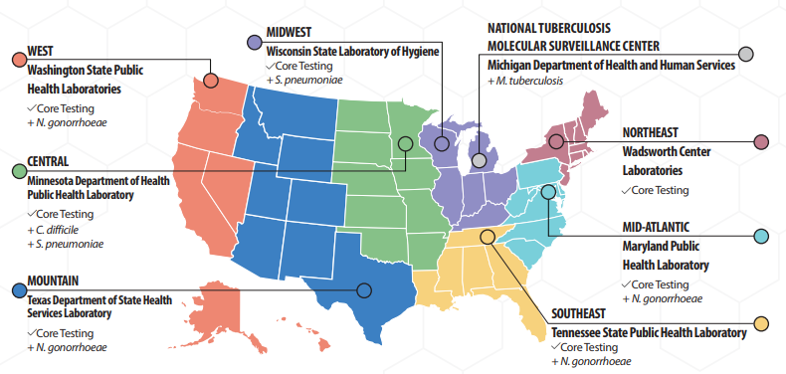
2017 – Antibiotic Resistance Laboratory Network Established

Slide 9
KPC-CRE in the U.S.
https://www.cdc.gov/hai/organisms.cre.trackingcre.html

Slide 10
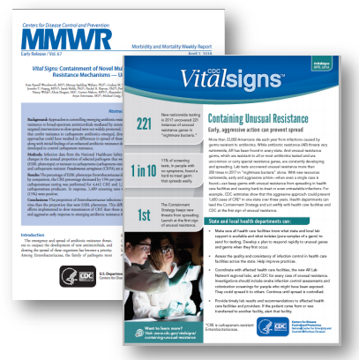
April 2018 Vital Signs
MMWR report summarized the experience over the first several months of improved lab testing by CDC’s Antibiotic Resistance Laboratory Network
Expanded laboratory testing capacity in all 50 states, 5 cities, and Puerto Rico for rapid identification. Regional labs support colonization testing.
Health departments and health care facilities can work together to aggressively respond to protect patients from these threats and keep infections from spreading within and between facilities.

Slide 11
The Containment strategy
https://www.cdc.gov/vitalsigns/pdf/2018-04-vitalsigns.pdf

Slide 12
Or said another way…

Slide 13
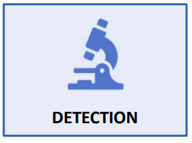
Containment Strategy – Facility Perspective
Is your clinical lab using current CLSI carbapenem breakpoints and/or testing for carbapenemases?
Is your lab submitting CRE isolates to the WPHL -> ARLN for mechanism testing?
Establish protocols that immediately notify health department, healthcare provider, and infection control staff of unusual resistance.
Validate new tests to detect the latest threats. If needed, use isolates from AR Isolate Bank.
https://wwwn.cdc.gov/arisolatebank/

Slide 14
Containment Facility – Facility Perspective (cont.)
Plan for unusual resistance arriving in your facility
Place patients with unusual resistance on contact precautions
Assess and enhance infection control
Communicate about status when patients are transferred
Ask about any recent travel* or health care to identify at-risk patients
*We recommend CRE colonization screening of all patients who have received healthcare in a foreign country within the last 6 months. (See 2013 CDC HAN)

Slide 15
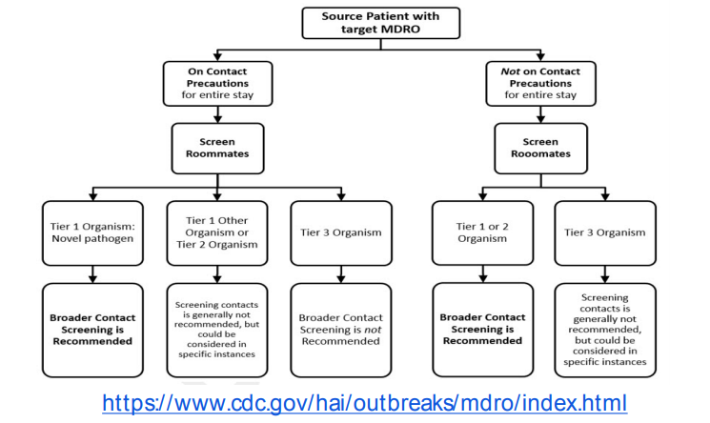
Approach to screening healthcare contacts
*CDC does NOT recommend screening healthcare personnel in most situations

Slide 16
Considerations for screening
Communicate with WDH about supplying/testing screening swabs for free
Need a defined population to screen
Who will collect swabs and have they been trained in proper collection?
Process for consenting patients
Follow-up plan for various possible outcomes

Slide 17
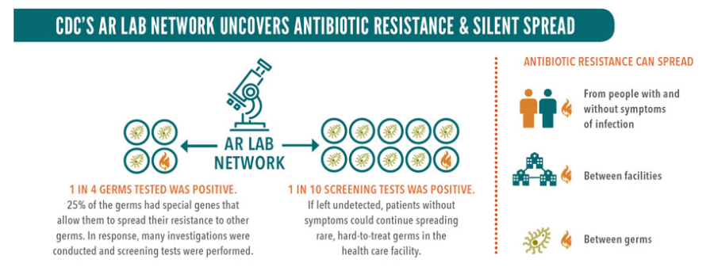
In 2017, 1 in 10 colonization screening tests was positive when tested at ARLN labs.

Slide 18
WY CRE Case Definition
The Wyoming Department of Health defines CRE as any Enterobacteriaceae that:
Are resistant to at least one carbapenem (including imipenem¹, meropenem, doripenem, or ertapenem) using the current M100-S25 CLSI breakpoints²;
OR
Test positive for carbapenemase production by the Carba NP test;
OR
Test positive for a known carbapenemase gene by nucleic acid amplification testing.

Slide 19
Warm-Up Exercise
Initials | Age | Gender | Specimen Collection Date | Specimen Type | Organism | Antibiotic Susceptibility | Carbapenemase Producer? | Which Reporting Criteria does this meet? | Reportable? (Yes/No/ Unsure)
PJ | 70 | F | 8/2/18 | BAL | Klebsiella pneumoniae | Ertapenem – S Meropenem – S Imipenem – S Ceftriaxone – R Ceftazidime – I | Neg
TJ | 84 | F | 8/8/18 | Blood | Klebsiella pneumoniae | N/D | POS
JD | 53 | M | 8/16/18 | Urine | Klebsiella pneumoniae | Ertapenem – R Meropenem – S Imipenem – I Ceftriaxone – R Cefotaxime - R Ceftazidime – R | Neg
KC | 62 | F | 8/24/18 | Abd. Abscess | Klebsiella pneumoniae | Ertapenem – R Meropenem – R Imipenem – R Ceftriaxone – R Cefotaxime - R Ceftazidime – R | POS

Slide 20
Tabletop Exercise

Slide 21
Case Study #1

Slide 22
Suzie Sanders
68 y.o. female resident of skilled nursing facility
CVA 3 years prior, with persistent right-sided hemiplegia
Arrives with Foley catheter and G-tube in place
In ED, was febrile at 39◦ C/ 102.2 ◦ F
WBC count was 26.4 x 103 cells/uL, with differential showing 77% segmented neutrophils, 6% lymphocytes, 8% monocytes, 9% band neutrophils
Blood and urine cultures collected
Started on empiric meropenem and vancomycin before being transferred to general medical unit in stable condition

Slide 23
Suzie Sanders (cont.)
- After 48 hours, urine culture grew out VRE
General medical attending discontinued vancomycin, switched to daptomycin due to concern for possible urosepsis
After one week, began to improve clinically, with decreased WBC and resolved fever

Slide 24
Daisy Dalton
72 y.o. female, Suzie’s roommate
Found unresponsive, febrile, hypotensive
Had been admitted 5 days prior for diabetic neuropathy, with non-healing ulcer on left foot
Transferred to MICU in critical condition
Blood cultures collected after transfer grew multidrug-resistant Klebsiella pneumoniae

Slide 25
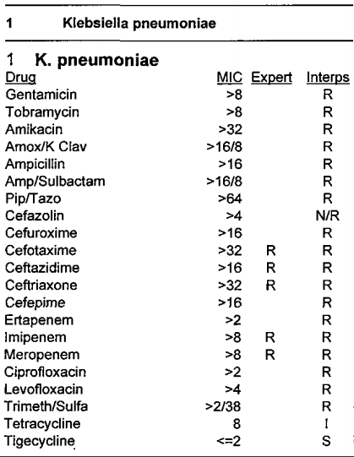
Figure 1 ID/AST Report
**PAUSE**
Answer questions 1 & 2

Slide 26
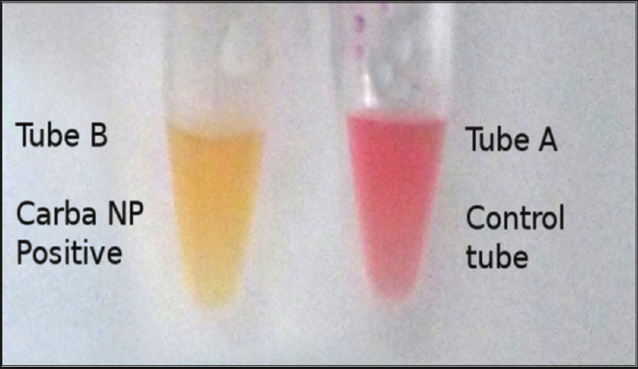
INJECT: Carbapenemase Lab Results Arrive
WPHL performs Etest which confirms the resistance profile and CarbaNP Test, which is positive
Lab requests the isolate be sent to the Texas ARLN laboratory for further confirmatory testing.
KPC producing Klebsiella pneumoniae
**Pause** Answer Questions 3-5

Slide 27
INJECT
IP obtains order for rectal swab for Ms. Sanders.
Laboratory follows broth enrichment procedure using 10ug meropenem disk and performs identification and susceptibility testing on distinct colony morphologies recovered upon subculture to MacConkey agar.
MDR-K. pneumoniae with similar susceptibility profile to Ms. Dalton’s bacteremia isolate is identified. This isolate is also KPC positive.
**Pause** Answer questions 6 & 7

Slide 28
INJECT
4 more patients on the unit, all in rooms that are physically near Ms. Sanders’s room, also KPC+.
3 patients’ KPC+ isolates were also K. pneumoniae, while one patient had a KPC+ E. coli.
**Pause** Answer questions 8-10.

Slide 29
Case Study #2

Slide 30
Mary Smith
70 y.o. female resident
Admitted to Shady Lane Manor for continued care of congestive heart failure
History of diabetes with chronic kidney disease and pneumonia
Recent admissions to Good Health Hospital, Get Well Medical Center and Sunny Day Home for Elders

Slide 31
Mary Smith (Cont.)
Screened for CRE on admission and four days after, lab notified facility that she had
K. pneumoniae that was MHT+
Enterobacter cloacae that was NDM+ by PCR
Currently ventilated and has PICC line
**Pause** Answer Question 1

Slide 32
INJECT
Ms. Smith was placed on Contact Precautions because she is ventilated and incontinent of urine.
**Pause** Answer Question 2

Slide 33
INJECT
Shady Lane Manor decided to perform surveillance cultures on the 8 other residents that were on the unit at the same time as Ms. Smith.
**Pause** Answer Questions 3 & 4

Slide 34
INJECT
Upon notification and discussion with Get Well Medical Center, the State Health Department (SHD) determined that Ms. Smith was in Good Health Hospital prior to being transferred to Get Well Medical Center
Good Health Hospital is in Other State’s jurisdiction. SDH notified Other State.
**Pause** Answer question 5

Slide 35
INJECT
WDH determined that Ms. Smith had several admissions to Good Health Hospital
During the discussion, WDH learned that Good Health Hospital routinely performs surveillance cultures for CRE
Ms. Smith was found to have negative surveillance cultures on her last two admissions
Good Health Hospital reported that Ms. Smith had recently been at Sunny Day Home for Elders

Slide 36
Patient Transfer Diagram
Wyoming
Other State
Shady Lane Manor
Good Health Hospital
Get Well Medical Center
Sunny Day Home For Elders
**Pause** Answer questions 6 & 7

Slide 37
Open Discussion
What is one thing you could do now to improve detection of target pathogens?
What is one thing you could do now to increase use of colonization screening?
Are there tools, trainings, or approaches, you have found valuable?
What tools/data would be helpful for you in your facilities?
Are there any materials or resourced WDH can develop/provide to better support your infection control detection and containment work?

