Slide 1

The Power of Engagement to Influence Change
Barbara DeBaun, RN, MSN, CIC
WIPAG Conference
September 20, 2018

Slide 2
Learning Objectives
Describe 4 key myths associated with engagement
Describe 4 approaches to conquering engagement barriers

Slide 3


What are those bricklayers doing?

Slide 4
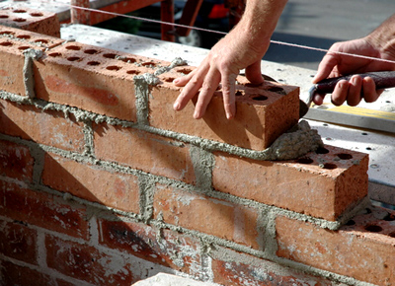
Bricklayer #1
“Putting a brick on top of another... isn’t that obvious?”

Slide 5

Bricklayer #2
“Building a wall for the west side of a church”

Slide 6

Bricklayer #3
“Creating a cathedral that will stand for centuries and inspire people to do great deeds”

Slide 7
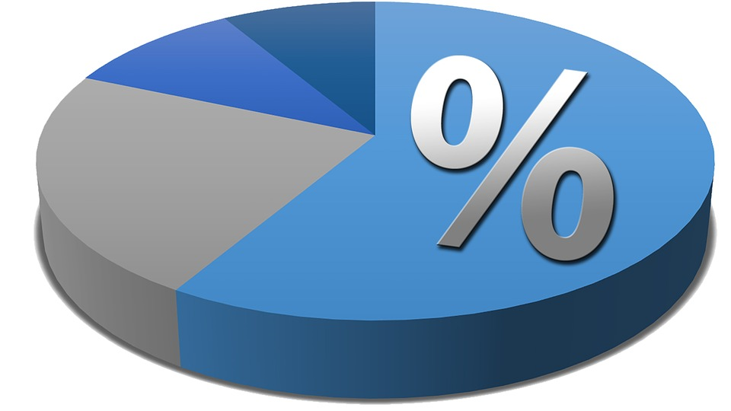
What percentage of your fellow nurses are:
Putting one brick on top of another?
Building a wall for a church?
Creating a cathedral?
Notes:
Ask participants to jot down the percentages for each. Get a show of hands for who had the majority for each.

Slide 8

Bricklaying Scenario #1
Can you think of a time you tried to engage one of your ‘one brick at time’ nurses?
How did that go?
What did you feel?
What might you do differently next time?
Notes:
Use worksheet. Give them a few minutes to discuss these questions at their tables. Ask for a few volunteers to share.
Task masters, no big picture

Slide 9

Bricklaying Scenario #2
Close your eyes
Think of a ‘building a cathedral’ nurse
What is special or unique about that nurse?

Slide 10



Only 30% of Americans are engaged in their job
Source: Gallup’s “State of the Global Workplace Report, 2013”
Notes:
According to the latest Gallup survey, the majority of American workers are “one brick at time’ people.

Slide 11
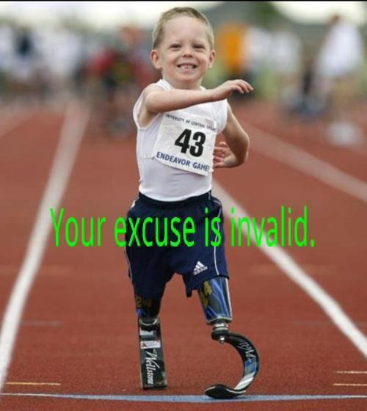

What engaged providers do . . .
Notes:
They wash when no one is watching.

Slide 12
The Four Myths of Engagement
1. Showing the Evidence is Sufficient
2. Everyone Engages at the Same Time
3. The Same Message Works with Everyone
4. Every Intervention is Equally Easy/Hard to Implement
Notes:
Much has been written about engagement. Here are 4 common myths that must be addressed.

Slide 13
The Four Rules of Engagement
1. Connect to the Core
2. Engage the Engaged
3. Customize Communication
4. Align and Segment
Notes:
And here are 4 approaches to the myths that will help us improve our chances of developing a highly engaged team

Slide 14

Myth #1: Show the Evidence
Notes:
Who remembers the famous line from this movie, Field of Dreams? “Build it and they will come”. What did this mean? Does this mean that if we show evidence that there is value in a specific therapy that people will automatically do it? Sadly, no.

Slide 15


Time from ‘bench’ to ‘bedside’
17 Years
Notes:
How many years, on average, does it take for clinically evidence based practices to become widely and reliably used? Approximately 17 years.

Slide 16
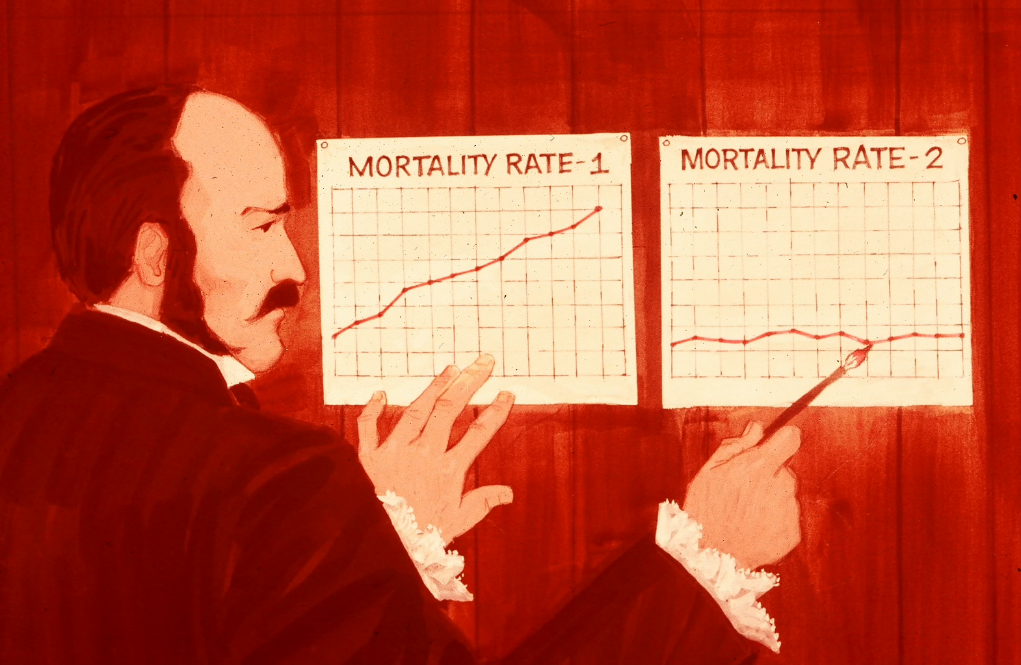
Dr. Semmelweis showed the evidence
Notes:
Dr. Semmelweis had data to demonstrate the mortality rates between the 2 groups who delivered infants. The doctors who also performed autopsies on the left and the midwives who had clean hands on the right. Did showing the evidence impact practice?

Slide 17
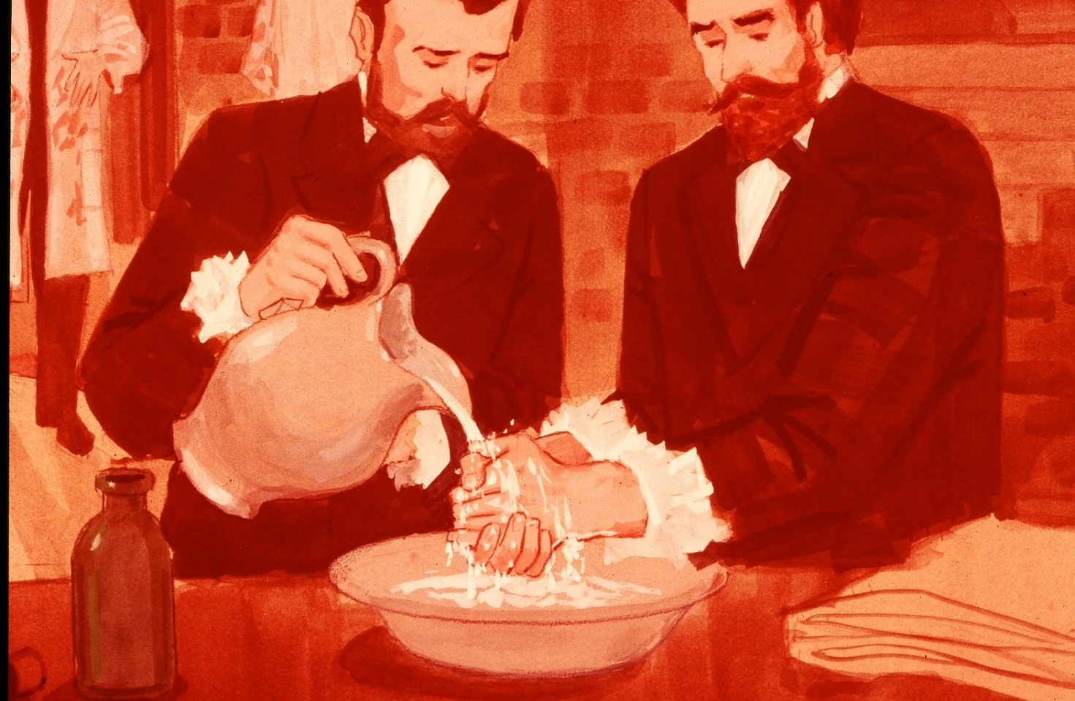
But we still don’t do it right
1847
Notes:
We have known for 170 years that clean hands are less likely to transmit disease.

Slide 18
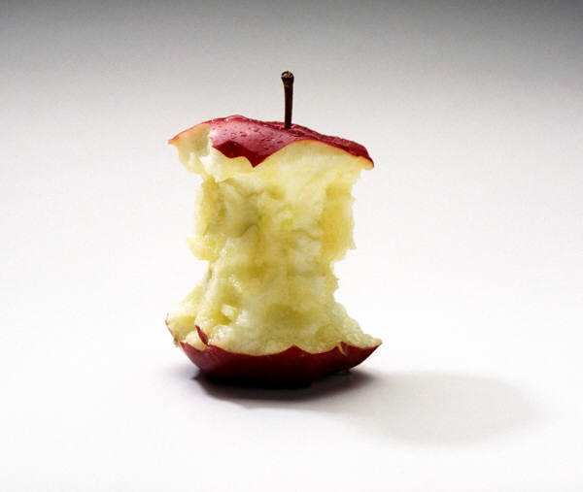
Rule #1: Connect to the Core
Notes:
So if showing the evidence isn’t adequate……we must connect to the hearts and souls….otherwise known as the core in order to increase engagement.

Slide 19
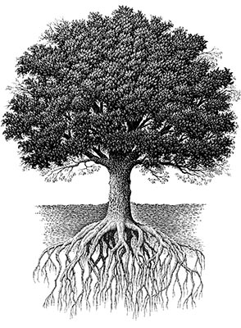
Meaningful Journey
Something BIG
Belonging
“I” make a difference
Notes:
Roots of Engagement lie in some key concepts. Let’s take a look at these one by one.

Slide 20

Being Part of Something Big
Notes:
Has anyone ever participated in a fundraising walk/bike ride/run? What motivated you? Would you have been as successful if you were doing this solo? Why was the IHI 100K lives campaign so successful? The chance to be part of something BIG.

Slide 21

Sense of Belonging
Notes:
What I do impacts everyone else, part of the team. I am supposed to be here and am an important part of the solution.

Slide 22

Meaningful Journey
Notes:
How will we know if we have ‘gotten there’ if we don’t know where we are going? This is why a SMART Aim statement is so key.

Slide 23
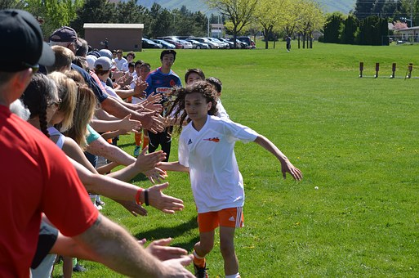
Contribution
Notes:
Everyone gets to play, even if you are not good. Everyone contributes. Connects to core when it is clear they are making a contribution. Even though you are not taking care of patients, you will make a big difference. Think about the Environmental Service aid who cleans the room of a patient with CDI…how is that person’s contribution recognized and rewarded? How do you actually make these improvements happen?

Slide 24
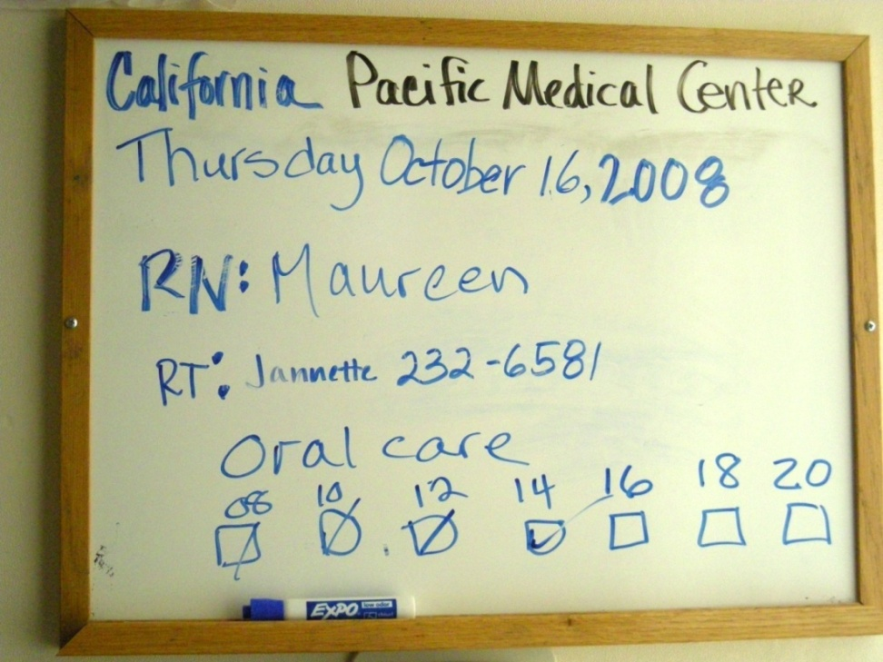
How do ‘I” impact change?
Notes:
Here are a few examples. The slide on the left is a great example. At this hospital in San Francisco, the Respiratory Therapists asked why they were not partly responsible for providing oral care to their ventilated patients. They saw this as partly their role and responsibility and offered to make it easy for the nurse to know whether oral care had been provided. They used these boxes on the whiteboard to document if oral care was done. This greatly impacted the RT’s engagement and belief that they contributed to the VAP prevention goal. I have a personal story to share about a housekeeper who called the Rapid Response Team when he believed a patient was ‘acting different’ and was much less alert that previous days (he had cleaned the patients room the past 3 days and had meaningful conversations with the patient so he knew this wasn’t normal for her. He shared his observations with the nurse but was dismissed as the nurse thought the patient was just sun-downing. The EVS worker knew that anyone could call the RRT so he did. Turns out he was right. The patient’s mental confusion was a sign of sepsis. He saved her life.

Slide 25

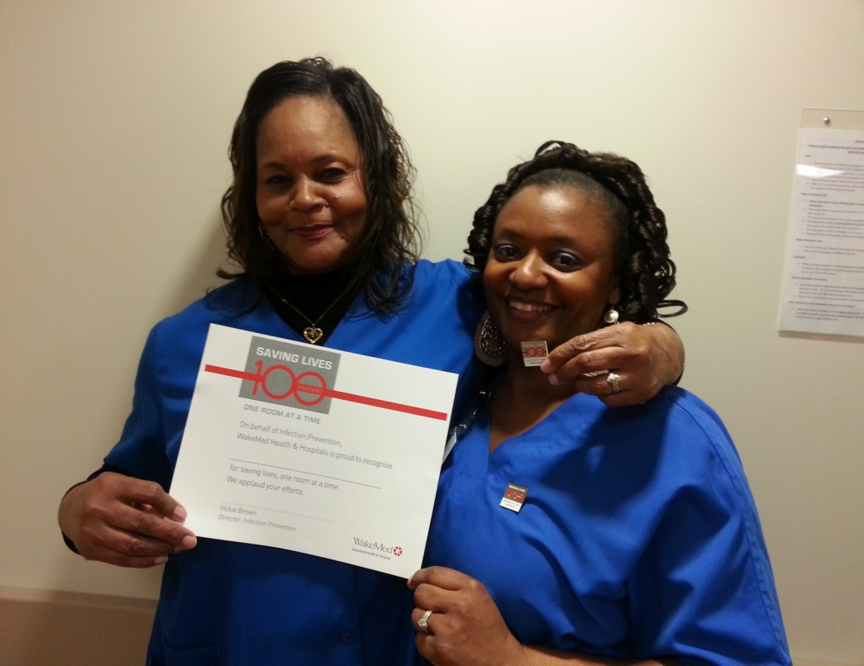
EVS Engagement
Notes:
WakeMed North Carolina; engagement of EVS

Slide 26
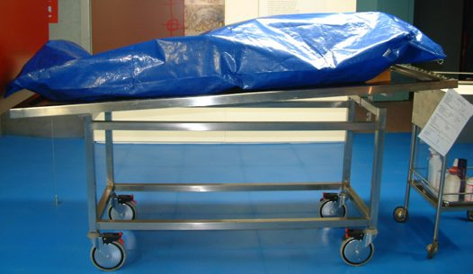
Notes:
Years ago, Kaiser Permanente held a CDI summit and invited teams from all sites (including nursing, ID, IP, quality, pharmacy, environmental service). At the end of the full day, they darkened the room and said they wanted to close by sharing the names, ages and specific Kaiser locations of every patient who had DIED as a result of healthcare associated CDI. Go to next slide.

Slide 27
Mary B 46 SF
John J 57 SSF
Frank K 89 Val
George R 90 Sac
Sue T 38 SR
Notes:
The names on this slide are fictitious however demonstrates what they shared. It took over 5 minutes to click through every name. You could hear a pin drop in the room. Again, this put a name/age/location of every single patient who died from HA-CDI in the past year. This Connected to the core…BIG time.

Slide 28

Celebrate the ‘non-events’
Notes:
Another way to Connect to the Core. Ask if anyone shares stories about patients who have had an HAI or other HAC during meetings at their hospital? Likely many hands will go up. Then ask whether they share stories about patient who were a really high risk for harm, yet did not develop an HAI or other event. For example, a patient admitted to the ICU who needed a urinary catheter, a central line, a ventilator….and had multiple opportunities for skin breakdown, over-sedation (etc) yet DID NOT have anything bad happen. Hopefully a few hands will raise. If not……use this a suggestion to Connect to the Core. Imagine the patient who was at such high risk for harm, yet we did everything right and nothing bad happened….celebrate that!!

Slide 29
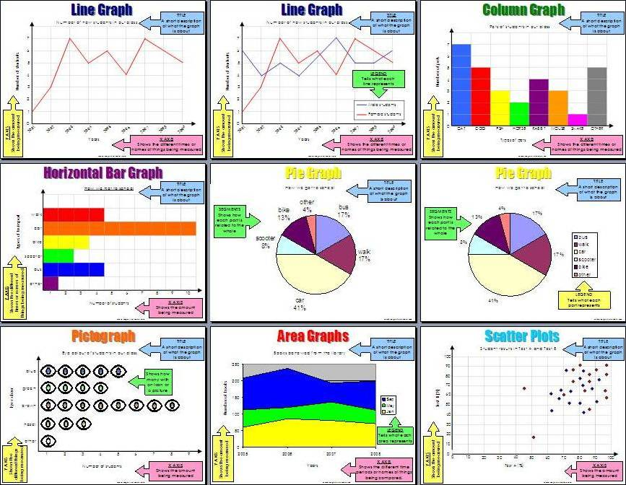
Group Exercise: Data
Have you found a way to engage others through the use of clinical data?
What did you do and why was it successful?
Notes:
Group Exercise: Ask them to discuss at their tables how they use date to engage. Give them a few minutes. Share

Slide 30
Safety Cross
 | 2012
 | January
 | February
 | March
April | May | June
July | August | September
 | October
 | November
 | December
 | 2013
 | January
 | February
 | March
April | May | June
July | August | September
 | October
 | November
 | December
1 or more harms No Harms
Notes:
This is a Safety Cross that makes it easy to see the number of months where no harms occurred. A good engagement of staff who are not motivated by run charts, rates or ratios.

Slide 31
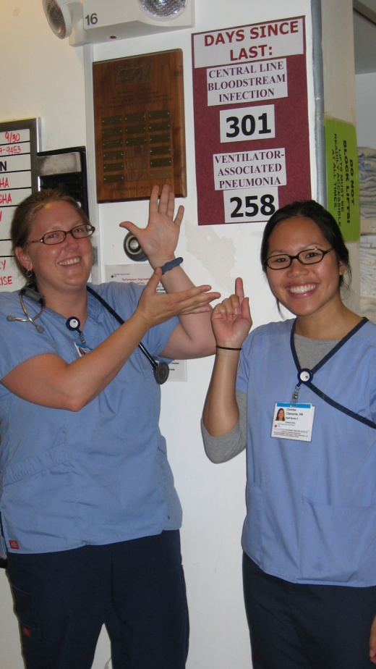
Transparency Engages Staff
Courtesy of St. Francis Hospital, San Francisco
Notes:
Unit based numbers can be great engagement tools.

Slide 32
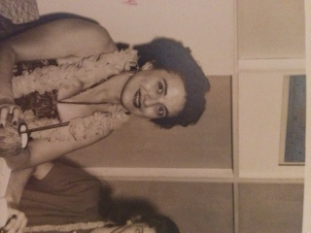
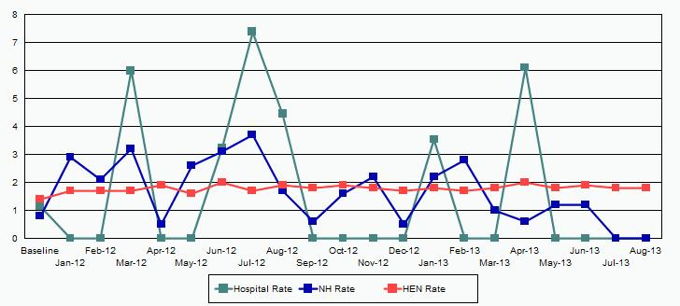
CAUTI in the ICU
Courtesy of Martha Leighton; Eliot Hospital, Manchester, NH
Notes:
Our rates aren’t that bad, less than 10%. It matters if it is your Grandparent
Have to make this real
Each patient counts
Use each person’s event instead of rates

Slide 33
Rule #1: Connect to the Core
Non-engaging methods
Engaging methods
Non-Engaging Methods
Sharing medical literature passively
Doing something just because TJC says you must
Creating and disseminating a policy
gaging Methods
Describing how a project fits into the bigger picture (realistic future state)
Aligning the project with professional identity
Show how staff work has impacted the project
Notes:
Summarize the non-engaging methods and compare to engaging methods to connect to the core

Slide 34

Myth #2: Everyone Engages at the Same Time

Slide 35

Innovation is non-linear

Slide 36
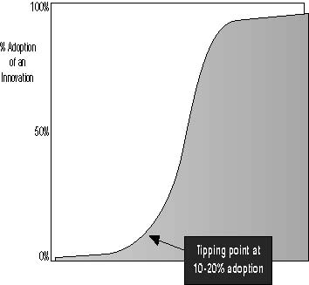
Innovation Adoption S-curve

Slide 37

Rapid Response Teams

Slide 38


Rule #2: Engage the Engaged

Slide 39

Use Early Adopters to Create Change

Slide 40
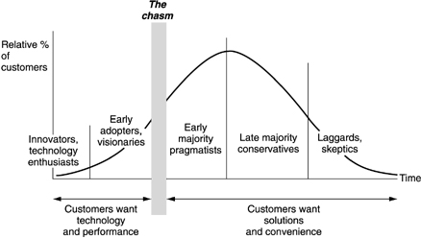
Fertile Ground for Champions
Where Champions Work
Where Champions Work

Slide 41
Rule #2: Engage the Engaged
Non-engaging methods
Engaging methods
Non-Engaging Methods
Starting with an entire department
Getting “buy-in”
Trying to convince a laggard first
Utilizing an early adopter who has little credibility
Engaging Methods
Seeking champions who are opinion leaders (may not have a formal title)
Starting small on a project with a few key participants
Spread after early adopters work out most of the bugs
Use early adopter peers as spokesperson for spread

Slide 42

Myth #3: The Same Message Works with Everyone
Notes:
Ask if anyone has teenagers. Offer your condolences ☺. Then ask whether they communicate in the same way to both of them…..likely not.

Slide 43
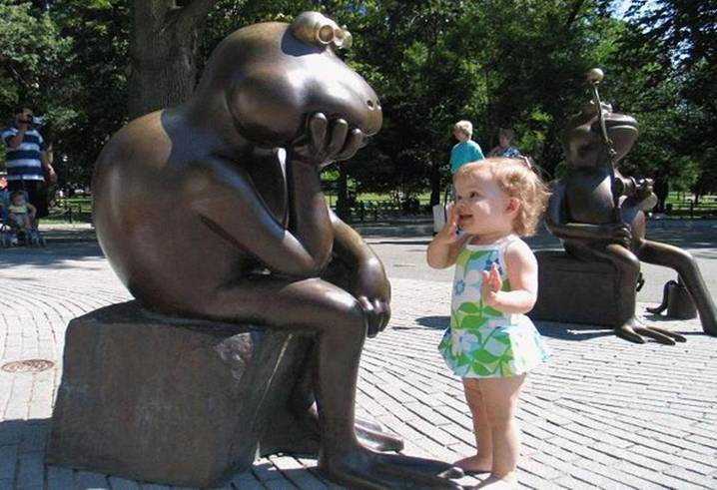
35,000 per day
Notes:
We are bombarded with 35K messages a day; emails, texts, billboards, TV, movies, radio, Twitter, Facebook, blogs…plus newspapers, magazines, and books; we are cluttered with words; how do we choose which messages to tune in and which ones to tune out?

Slide 44
“The single biggest problem in communication is the illusion that it has taken place.”
George Bernard Shaw

Slide 45
Brief Exercise
What percentage of your daily communication at work is received:
A) Face-to-face with another person?
B) Verbal, but not face-to-face (Telephone/webinar)?
C) Written (email, text, flyer, snail mail)?
Notes:
Ask each person to jot down the percentages for them personally. Stress this is at work, not at home.

Slide 46



How do YOU communicate?
Notes:
Ask for some to share their percentages. If anyone says that most of their work communication at work is ‘face to face’ then ask how they make that happen. Likely, “face to face” will be the lowest for most. So how does this impact engagement and communication?

Slide 47











Notes:
You can joke about remembering a time when you had to actually get off the couch to change the channel on the tv (that only had 5 channels to begin with). We now live in a Visual Age: 77% of Americans get about 90% of their news from TV; 47% get all their news from TV; video and web conferencing are replacing on-site face-to-face meetings; digital video recording systems are becoming common place; kids now log about 22K hours watching TV by age 19; more than twice the time spent in school

Slide 48
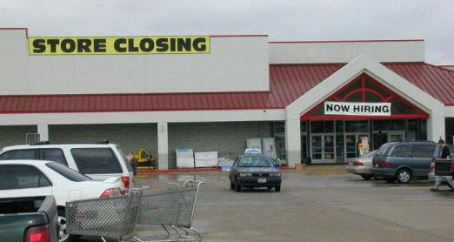
Notes:
Share this and next slide as examples why communication in our lives can be so confusing.

Slide 49

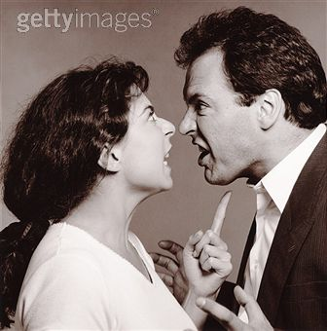
How do we engage or influence others?
Notes:
When we are trying to influence/engage another person we have 3 tools. Let’s start with the first (next slide)

Slide 50
7%
Notes:
We have words. When trying to influence another person how much do our words count for the total influence (remember, we have 3 tools and the percentages must add up to 100). Have them guess. Then click to display the “7%”. Emphasize that our actual WORDS count for very little. So what else do we have? Next slide.

Slide 51

38%
Notes:
We have tone of voice. So we have used 7% (for our words) so far. Have them guess the percentage impact of our tone of voice. Click and show the ‘38%. So what is left? Next slide.

Slide 52

55%
Notes:
Body language. Yes, words count for 7%, tone of voice is 38% and body language counts for a whopping 55%. Wow. So this means that we could be saying some very powerful things but if our body language is a turn off we are doomed. Ask them what kinds of body language should be avoided? They will likely say crossed arms, eye rolling, watching the clock, checking your phone, and others. This really helps to hit home the problem that so much communication these days is not in person and not verbal. It is just words in a text, email or tweet.

Slide 53

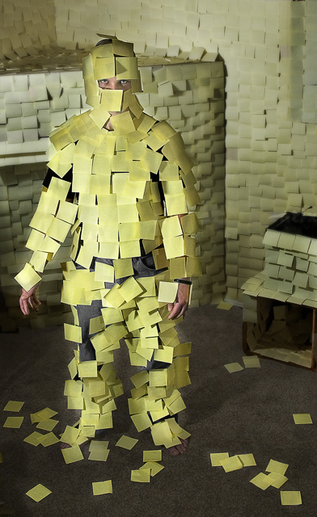
Notes:
This is a great resource for tips on how to communicate in a way that not only engages, but is memorable.

Slide 54
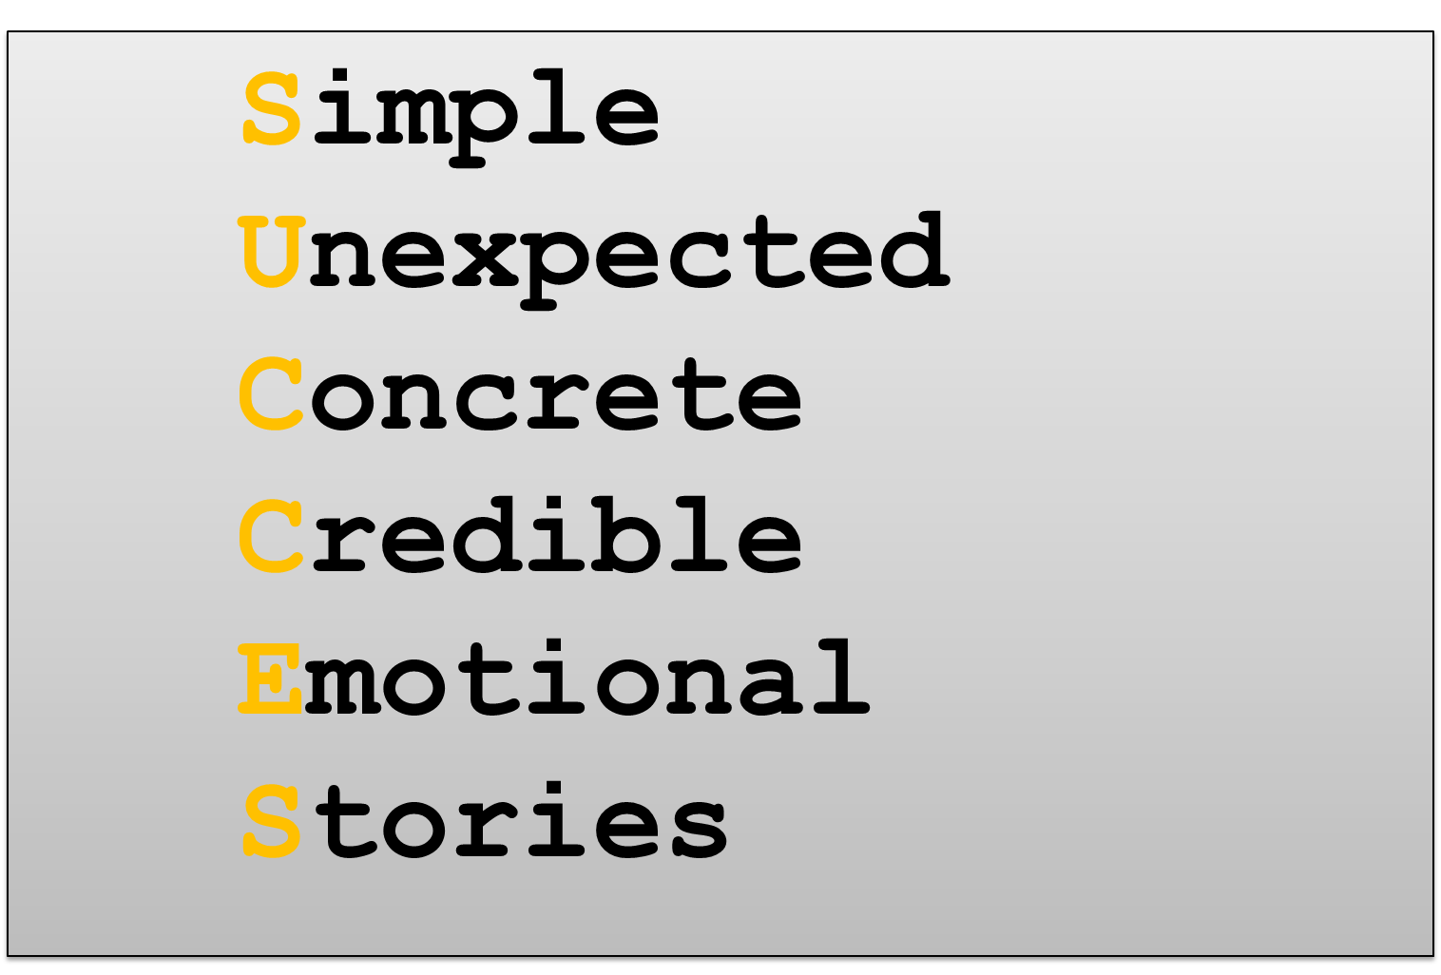
The Message Matters

Slide 55

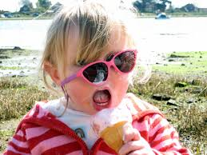
The Messenger Matters
The Nurse I want taking care of my loved one
Anyone else

Slide 56
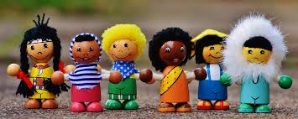
Be Different…take a risk…get attention
Notes:
A key concept discussed in make To Stick is that the messenger matters. Always ask “Who should be the main communicator”. Peers like to hear from peers. Can you think of effective programs that use ‘real people who have had real problems’ to engage and motivate others (e.g. Weight Watchers, AA). How about a patient who was harmed telling his/her personal story?

Slide 57

Notes:
Here is an example of a campaign from California Pacific Medical Center that was focused on getting foley catheters removed. They came up with this clever, very sticky message

Slide 58
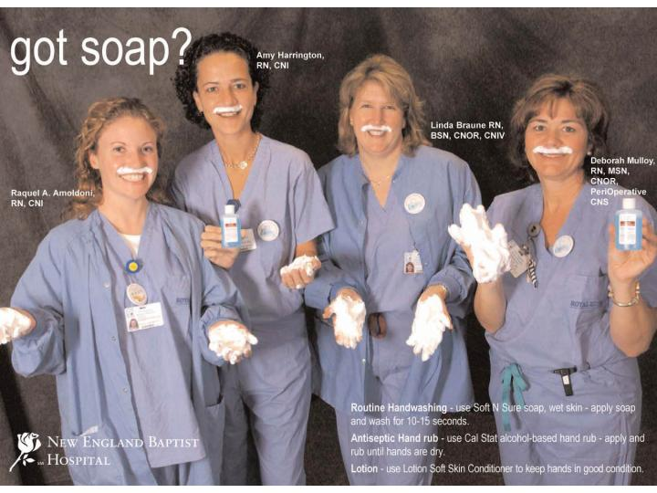
Notes:
New England Baptist Hospital featured their very own staff in this Hand Hygiene Campaign. Fun and very engaging.

Slide 59

Notes:
El Camino Hospital in California asked their Sr. Leaders to pose with silly rubber bugs on their fingers. They made life sized posters and placed them around the hospital. This sent a positive message to all including patients/families.

Slide 60

Rule #3 Customize Communication
Rule #3: Customize Communication

Slide 61
Customize the WAY You Communicate
SHARE
INFORMATION
SHAPE
BEHAVIOR
General
Publications
flyers
newsletters
videos
articles
posters
Personal
Touch
letters
cards
postcards
Interactive
Activities
telephone
email
visits
seminars
learning sets
modeling
Public
Events
Road shows
Fairs
Conferences
Exhibitions
Mass meetings
Face-to-face
one-to-one
mentoring
seconding
shadowing
(C) 2001, Sarah W. Fraser
Adapted from Ashkenas, 1995
Notes:
-

Slide 62

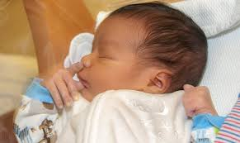
Flu Shots

Slide 63
Rule # 3: Customize Communication
Non-engaging methods
Engaging methods
Non-Engaging Methods
Don’t worry about the messenger
Assume only people with a title can communicate
Use only e-mail to “get the word out”
Using the same speech and arguments for change to everyone
Engaging Methods
Choose the messenger wisely
Adapt your message to the stage of implementation and the readiness of your audience
Simplify your message

Slide 64
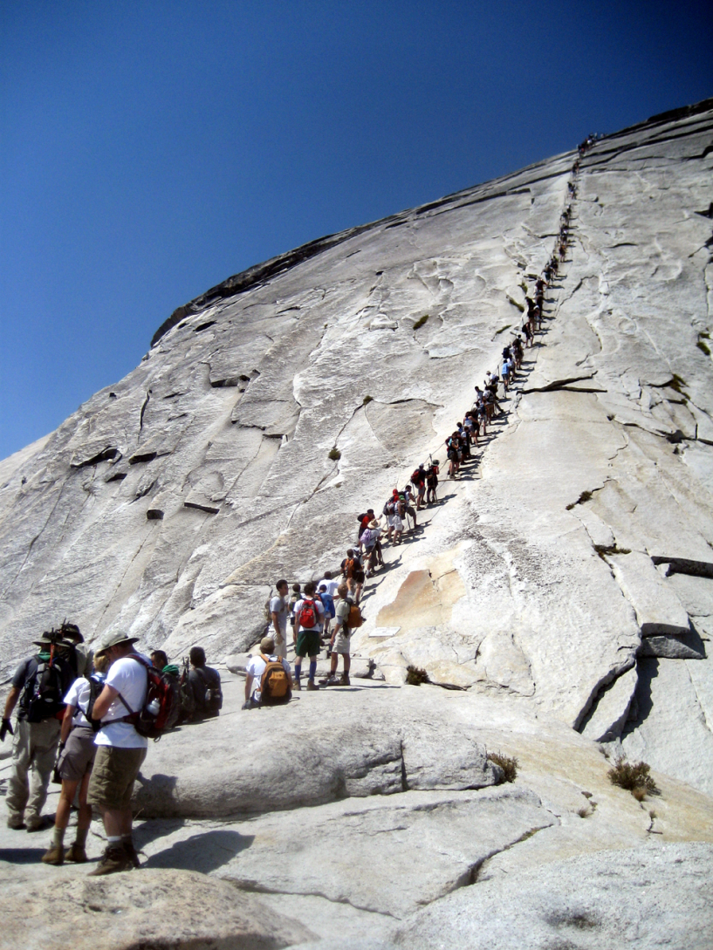

Myth #4: Every Intervention is Equally Easy to Implement

Slide 65
Roger’s Diffusion Model
Key factors
The innovation must be perceived to have:
Relative Advantage
an advantage over the "old" way of doing
things
Complexity
low complexity, i.e., easy to learn, use, teach
or implement
Observability
visible, observable improvement over the "old“
way of doing things
Compatibility
compatibility with current ways of doing things
Trial-ability
the ability for the innovation to be tried in
pieces or without a full commitment
Notes:
Published in 1995. First studied with new grain adoption in Iowa. Describes many innovations.
Relative advantage – must be perceptibly obvious. Explains crisis and mandate effects
Complexity – part of difficulty deploying CPOE. Version one is simple
Observability -

Slide 66
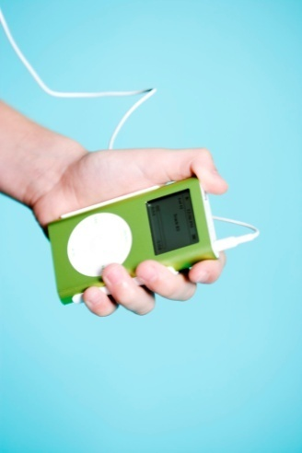
Key Factor | Likelihood (1-5)
Relative Advantage | 5
Complexity | 4
Observability | 5
Compatibility | 5
Trial-ability | 3-5

Slide 67
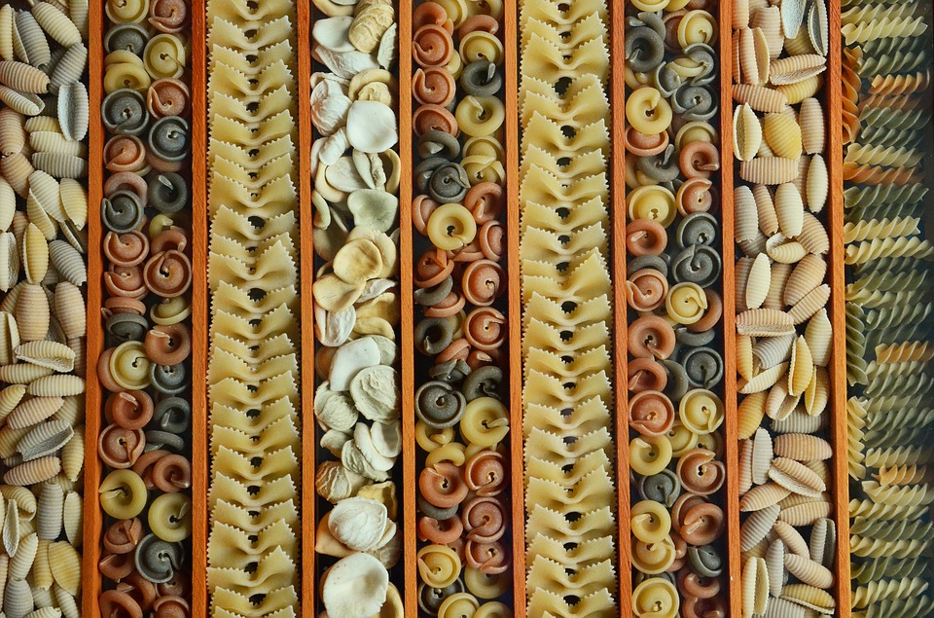
Rule #4: Align and Segment

Slide 68
Hand Hygiene
SSI
CAUTI
CDI
CLABSI
Sepsis
VAE
MDRO
SOAP-UP
Notes:
All HAI & MDRO
7 topics

Slide 69
Get UP
Falls
Delirium
VTE
PrU
Readmissions
VAE
CAUTI
GET-UP
Notes:
Jackie:
Get up Mobility program hospital wide- MS and ICU
Impacts 7 harm topics
Focus on cross cutting

Slide 70
Rule # 4: Segment & Align
Non-engaging methods
Engaging methods
n-Engaging Methods
Trying an intervention on the hardest group of patients
Developing a rigid work plan based on prior experience
Running multiple simultaneous projects with the same strategy
Engaging Methods
Start small where you are most likely to be successful
Use cross-cutting approaches where possible
Adapt implementation approaches to the specifics and challenges of each intervention and unit

Slide 71
The Four Rules of Engagement
1. Connect to the Core
2. Engage the Engaged
3. Customize Communication
4. Align and Segment

Slide 72

Engagement doesn’t come easy for all

Slide 73
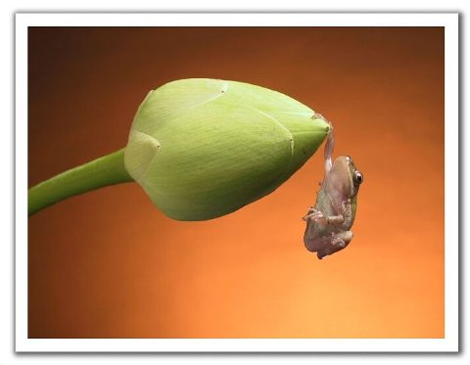
Barbara DeBaun, RN, MSN, CIC
Improvement Advisor
bdebaun@cynosurehealth.org

