Slide 1
3 Ps To Prevent HIV Transmission (oPEP, PrEP, nPEP)
Donna E. Sweet, MD, AAHIVS, MACP
Professor of Medicine
The University of Kansas School of Medicine - Wichita

Slide 2
P₃
Occupational Post Exposure Protocol (oPEP)
Non-Occupational Post Exposure Protocol (nPEP)
Pre-Exposure Protocol (PrEP)

Slide 4
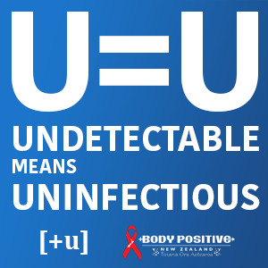
There is now evidence-based confirmation that the risk of HIV transmission from a person living with HIV (PLHIV), who is on Antiretroviral Therapy (ART) and has achieved an undetectable viral load in their blood for at least 6 months is negligible to non-existent.
While HIV is not always transmitted even with a detectable viral load, when the partner with HIV has an undetectable viral load this both protects their own health and prevents new HIV infections.
https://www.preventionaccess.org/consensus

Slide 5
Treatment as Prevention: HPTN 052–96% Reduction in HIV Transmission
Kaplan-Meier estimate for cumulative probabilities of linked HIV-1 transmission between partners among those in the early-therapy and delayed-therapy groups
HIV serodiscordant couples randomized to receive either early or delayed ART
Early ART was initiated in the HIV-infected partner at enrollment
Delayed ART was initiated after 2 consecutive CD4 cell counts ≤250 cells/mm³ or the development of an AIDS-related illness
1.0
0.3
0.8
0.2
0.6
0.1
Delayed
Cumulative Probability
0.4
Early
0.0
0
1
2
3
4
5
0.2
0.0
0
1
2
3
4
5
Years Since Randomization
Number at Risk
Early
893
658
298
79
31
24
Delayed
882
655
297
80
26
22
Cohen MS, et al. N Engl J Med. 2011;365:493-505.
Notes:
HPTN 052 included 1763 serodiscordant couples randomized to immediate initiation of ART in the HIV-infected partner upon enrollment (n = 886) or delayed initiation of ART until 2 consecutive CD4 cell counts ≤250 cells/mm³ or development of an AIDS-defining illness (n = 877)¹
On April 28, 2011, an independent Data and Safety Monitoring Board (DSMB) concluded that the trial had demonstrated a benefit of immediate ART with respect to transmission and a trend suggesting clinical benefit to the HIV-infected partner¹
A total of 39 participants uninfected at enrollment became infected. Of these, 28 were genetically linked, meaning the HIV-infected partner was the likely source of the infection; only one linked infection occurred in the immediate ART arm. This single event appears to have occurred before viral suppression was achieved with ART ^{1,2}
Of the 28 linked infections, 18 were female-to-male transmission¹
References
Cohen MS, et al. Prevention of HIV-1 infection with early antiretroviral therapy. N Engl J Med. 2011;365:493-505.
HPTN 052: Initiation of antiretroviral therapy (ART) prevents the sexual transmission of HIV in serodiscordant couples [fact sheet]. http://www.hptn.org/web%20documents/HPTN052/HPTN%20Factsheet_InitiationART4Prevention.pdf. Accessed June 6, 2012.

Slide 6
HPTN 052: HIV Transmission Reduced by 96% in Serodiscordant Couples
Total HIV-1 Transmission Events: 39
(4 in immediate arm and 35 in delayed arm; P < .0001)
Linked Transmissions: 28
Unlinked or TBD Transmissions: 11
Delayed Arm: 27
Immediate Arm: 1
Single transmission in patient in immediate ART arm believed to have occurred close to time therapy began and prior to suppression of VL
P < .001
Cohen MS, et al. IAS 2011. Abstract MOAX0102. Cohen MS, et al. N Engl J Med 2011
Notes:
TBD, to be determined.

Slide 7
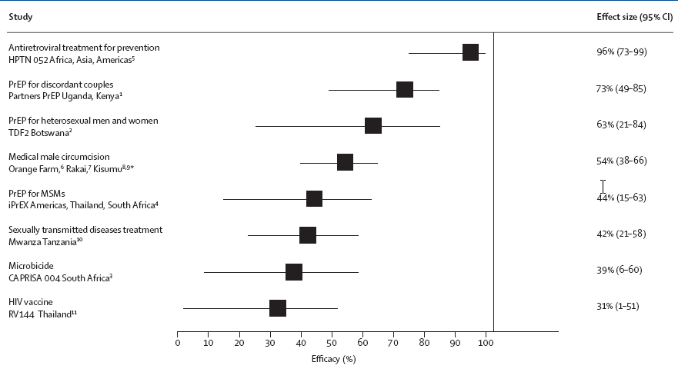
Efficacy of HIV Prevention Strategies From Randomized Clinical Trials
Abdool Karim SS, et al. Lancet 2011; Jul 17.
Notes:
CI, confidence interval.

Slide 8
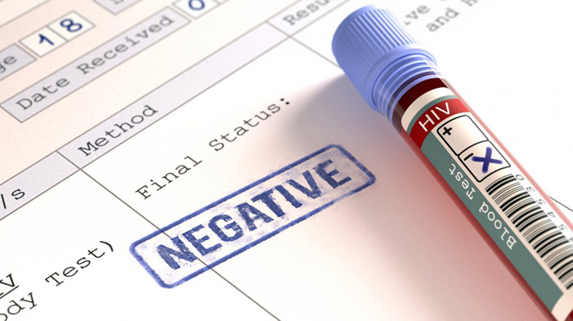
So…The Test is Negative But a High Risk Testee

Slide 9
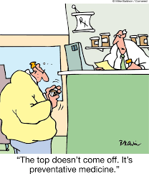
“The top doesn’t come off.
It’s preventative medicine.”

Slide 10
P₁
Pre-Exposure Protocol (PrEP)

Slide 11
Missed PrEP Opportunities
66% of patients newly diagnosed with HIV in South Carolina had, on average,
6.9 health care visits before their diagnosis
Source: Infectious Disease News. July 2019. Healio.com/ID
https://www.healio.com/infectious-disease/hiv-aids/news/in-the-journals/%7b8a567340-b2c1-4ee5-9750-400d08548dc9%7d/two-thirds-of-patients-with-hiv-had-missed-opportunities-for-prep

Slide 13
FTC/TDF (TRUVADA) FOR PrEP INDICATION
FTC/TDF is indicated in combination with safer sex practices for PrEP to reduce the risk of sexually acquired HIV-1 in adults at high risk
This indication is based on clinical trials in MSM at high risk for HIV-1 infection and in heterosexual serodiscordant couples
emtricitabine (FTC) 200 mg
tenofovir disoproxil fumarate (TDF) 300 mg
Pill image is for illustration only.
MSM, men who have sex with men.
TRUVADA Prescribing Information. Gilead Sciences, Inc. 2016.

Slide 14
PrEP Facts
http://www.cdc.gov/vitalsigns/hivprep/index.html

Slide 15
CDC PrEP Guidance: Who is recommended for PrEP?
Daily oral PrEP is recommended for adults at substantial risk of acquiring HIV infection:
Sexually active MSM
Heterosexually active men and women
Injection drug users
 | MSM | Heterosexual Women and Men | Injection Drug Users
Detecting substantial risk of acquiring HIV infection | HIV-positive sexual partner Recent bacterial STI High number of sex partners History of inconsistent or no condom use Commercial sex work | HIV-positive sexual partner Recent bacterial STI High number of sex partners History of inconsistent or no condom use Commercial sex work In high-prevalence area or network | HIV-positive injecting partner Sharing injection equipment Recent drug treatment (but currently injecting)
MSM=men who have sex with men; STI=sexually transmitted infection.
CDC. Preexposure Prophylaxis for the Prevention Of HIV Infection in the United States -- 2014: A Clinical Practice Guideline. Section: Summary of Guidance for PrEP Use. May 2014. www.cdc.gov/hiv/pdf/guidelines/PrEPguidelines2014.pdf. Accessed 1/19/15.

Slide 16
TRUVADA FOR PrEP SHOULD BE USED AS PART OF A COMPREHENSIVE PREVENTION STRATEGY
Safer sex practices, including consistent and correct use of condoms, and reducing sexual risk behavior
Knowledge of their own HIV-1 status and that of their partner(s)
Regular testing for HIV-1 and other STIs
Counsel uninfected individuals to strictly adhere to their dosing schedule
TRUVADA for PrEP is not always effective in preventing the acquisition of HIV-1
The effectiveness of TRUVADA for PrEP in reducing the risk of acquiring HIV-1 is strongly correlated with adherence
TRUVADA Prescribing Information. Gilead Sciences, Inc. 2016.

Slide 17
TRUVADA FOR PrEP: REQUIREMENTS FOR INITIATION AND MONITORING FOR HIV-1 INFECTION
Confirm HIV-1 status prior to TRUVADA for PrEP initiation
X
Discontinue if an HIV-1 infection is suspected
Confirm negative HIV-1 status immediately prior to initiation
If signs or symptoms of acute HIV-1 infection (eg, fever, fatigue, myalgia, skin rash) are present and recent exposures (<1 month) are suspected, delay initiation for ≥1 month, then reconfirm HIV-1 status
Alternatively, confirm negative HIV-1 status with a test approved by the FDA to aid diagnosis of acute or primary HIV-1 infection
Screen uninfected individuals for HIV-1 infection at least every 3 months while they are taking TRUVADA for PrEP
If symptoms of acute HIV-1 infection develop following a potential exposure event, discontinue TRUVADA for PrEP until negative HIV-1 status is confirmed using a test approved by the FDA to aid diagnosis of acute or primary HIV-1 infection
HIV-1 resistance may emerge in individuals with undetected HIV-1 infection who are taking only TRUVADA because this does not constitute a complete ART regimen for HIV-1 treatment.
ART, antiretroviral therapy.
TRUVADA Prescribing Information. Gilead Sciences, Inc. 2016.

Slide 18
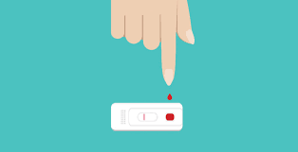
PCPs Often Prescribe PrEP Before Ordering HIV Testing
Only 77% of patients were tested for HIV…
and 81% were tested for STIs before initiating PrEP
Source: Infectious Disease News. July 2018. Healio.com/ID

Slide 19
Follow-up Visits
Screen for HIV-1 to confirm HIV-negative status every 3 months¹
Use an FDA-approved test to confirm HIV-negative status
Drug-resistant HIV-1 variants have been identified with use of TRUVADA for PrEP following undetected acute HIV-1 infection
Screen for STIs routinely (3-site testing)²
Not all STIs are symptomatic so test all sites of exposure including urethra, pharynx and rectum, regardless of condom use
Counsel on importance of adherence and using TRUVADA for PrEP as part of a comprehensive HIV prevention plan¹
Re-assess HIV risk at each visit
Monitor renal function to ensure CrCl ≥60 mL/min¹
Reassess potential risks and benefits of using TRUVADA for PrEP if a decrease in CrCl is observed during use
In patients at risk for renal dysfunction, periodically monitor serum phosphorus, urine glucose, and urine protein
If appropriate, consider continuing TRUVADA (emtricitabine 200 mg + tenofovir disoproxil fumarate 300 mg) for PrEP, 1 tablet PO daily, max 90-day supply¹

Slide 20
CONTRAINDICATIONS, DOSAGE AND ADMINISTRATION, AND HBV TESTING
Contraindications:
Do not use TRUVADA for PrEP in individuals with unknown or positive HIV-1 status
Dosage and Administration:
TRUVADA for PrEP in HIV-1 uninfected adults: one tablet once daily with or without food
HBV Testing
It is recommended that all individuals be tested for the presence of chronic HBV before initiating TRUVADA
TRUVADA Prescribing Information. Gilead Sciences, Inc. 2016.

Slide 21
Drug for PrEP
No Descovy

Slide 22
P₂
Non-Occupational Post Exposure Protocol (nPEP)

Slide 23
Non-Occupational Post Exposure Protocol (nPEP)
New!
8/30/2018
A 28 day course of HIV non-occupational Post-exposure prophylaxis (nPEP) should be considered for all HIV negative persons who seeks care <72 hours after:
a non-occupational exposure to blood genital secretions
other potentially infectious body fluids of a person who is living with HIV
is of unknown HIV status
IF that exposure represents a substantial risk for HIV acquisition.

Slide 24
Non-Occupational Post Exposure Protocol (nPEP)
New!
8/30/2018
Since adherence to nPEP medications is critical for nPEP effectiveness, it is preferable to prescribe regimens that minimize
Side effects
Number of pills per day.
For persons seeking care after a risky sexual exposure…
Common sexually transmitted infections should be treated presumptively,
Emergency contraception offered when indicated

Slide 25
nPEP Procedure
Evaluation
Date and time of possible HIV exposure
Is it within the past 72 hours?
Exposure Type
Details of the exposure (oral, rectal, vaginal, other mucosal membrane exposure)
The exposure should be valuated for risk of HIV acquisition potential based on
1 the type of HIV transmission with the potential benefits and risks of nPEP of treatment.
Sexual assault, the decision to initiate nPEP is based on whether a significant exposure risk has occurred rather than on age, or identity of the alleged assailant.

Slide 26
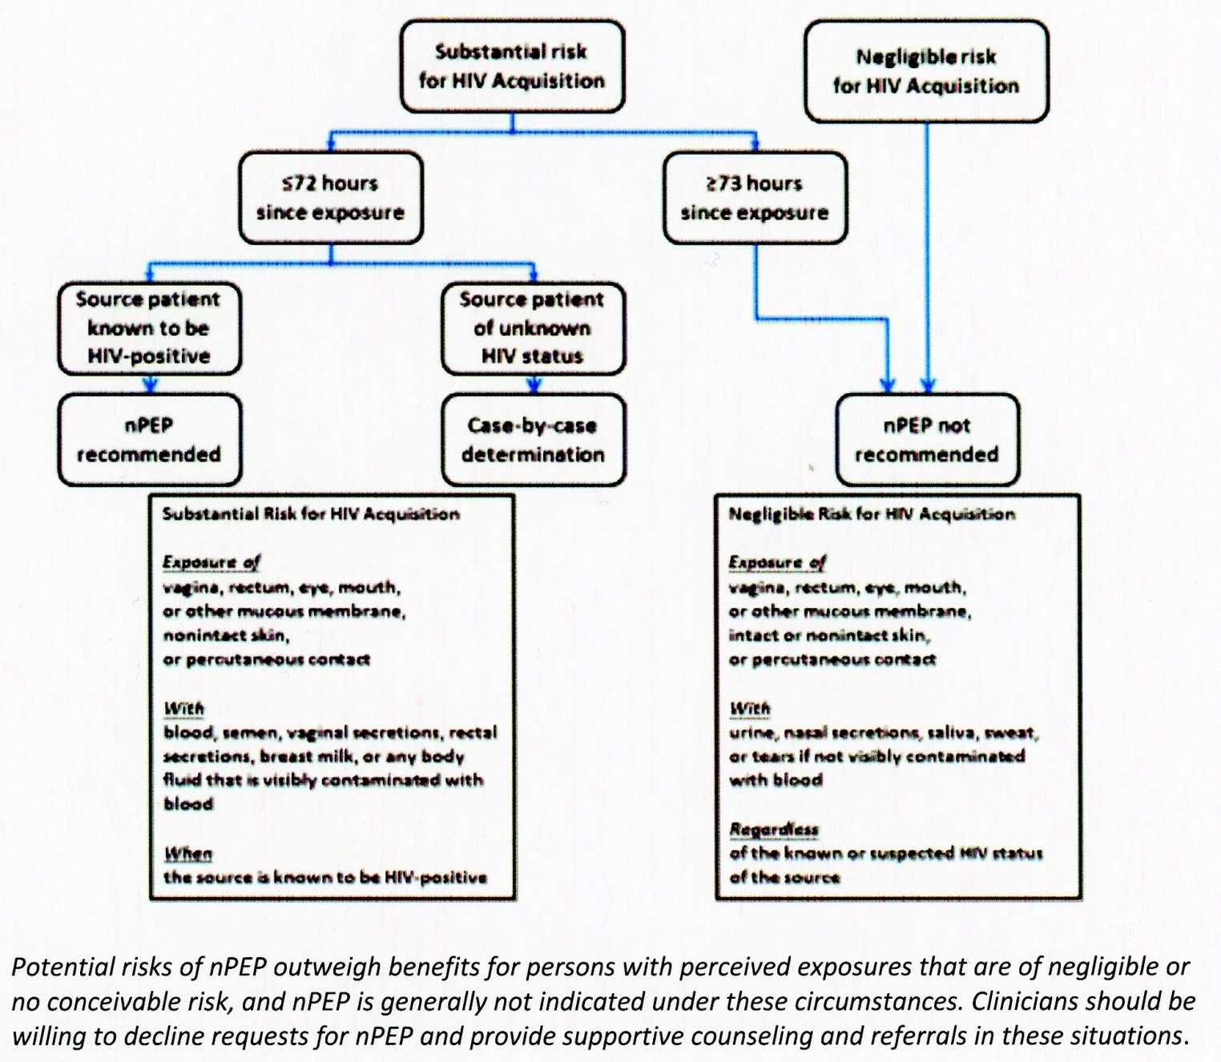
Algorithm of Evaluation and Treatment of Possible non-occupational HIV Exposures

Slide 27
Early Treatment of the Exposed Patient is the PRIORITY and should NOT be delayed while waiting for lab results
If the patient has a substantial risk for infection, and the HIV rapid test is negative (“non-reactive”, intiate nPEP within 1-2 hours of exposure or as soon as possible, as recommended by current guidelines and continue for 28 days.
If the patient is too distraught to engage in a discussion about the nPEP regimen at the initial assessment, the clinician should offer a first dose of the medications and arrange for follow-up within 24 hours to futher discuss the indications for nPEP if a significant exposure occurred.

Slide 28
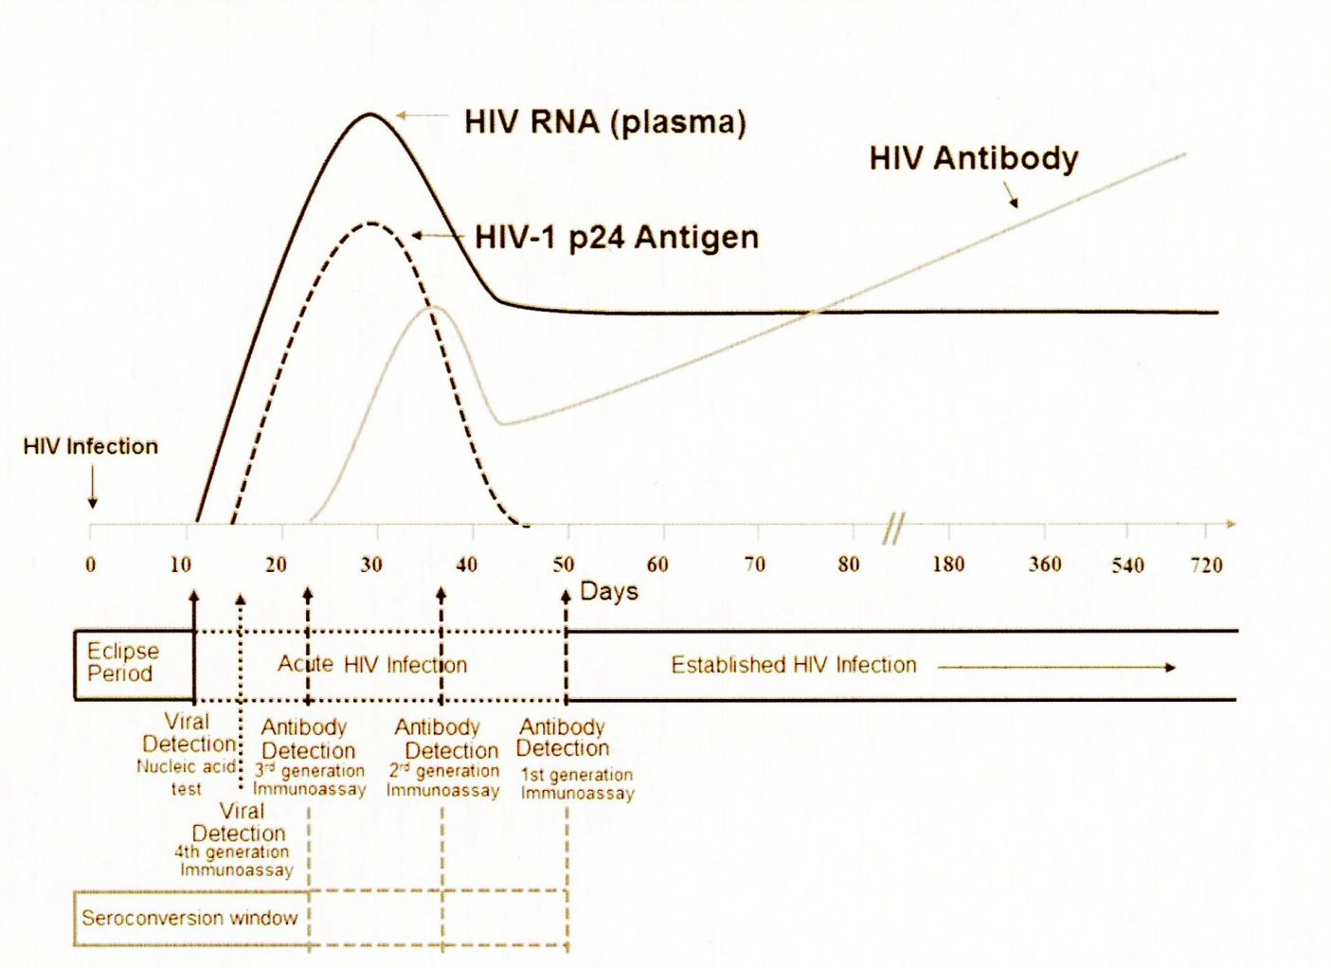
Sequence of Appearance of Laboratory Markers of HIV-1 Infection
Note. Units for vertical axis are not noted because their magnitude differs for RNA, p24 antigen, and antibody

Slide 29
nPEP: Laboratory Tests
HIV testing (preferably HIV Ag/Ab testing) at the time of nPEP initiation and again at 4-6 weeks and 3 months after nPEP initiation.
Alanine transaminase (ALT), aspartate aminotransferase (AST), serum creatinine and eGFR, at baseline and 4-6 weeks follow-up if taking nPEP.
Hepatitis C antibody, hepatitis B surface antigen, hepatitis B core antibody, and hepatitis B surface antibody at baseline* and, if negative, again at 6 months post-exposure.
If HIV seroconversion occurs (HIV test is “reactive” or positive after a previous “non-reactive” or negative test), contact an HIV expert or ID provider immediately and provide guidance to patient as recommended by expert. Linkage to care for antiretroviral therapy and HIV primary care is essential.

Slide 30
nPEP Medication Regimen
Preferred nPEP regimen for adolescents and adults (≥ 13 years old) with normal renal function (creatinine clearance >59 mL/min):
TDF/FTC 300/200 mg (TruvadaTM) 1 tablet PO daily + dolutegravir (TivicayTM)* 50 mg tab PO daily for 28 days**
OR
TDF/FTC 300/200 mg (TruvadaTM) 1 tablet PO daily + raltegravir (IsentressTM) 400 mg tab PO twice daily for 28 days
OR ALTERNATIVE
TDF/FTC 300/200 mg (TruvadaTM) 1 tablet PO daily + darunavir 800 mg (as two 400-mg tablets) PO daily + ritonavir 100 mg PO daily for 28 days
*If prescribing for a woman who may conceive while on the medication, or is in the early stages of pregnancy, do not prescribe dolutegravir.
** If pharmacist will not dispense less than a 30-day supply of nPEP medications (because of cost to pharmacist of removing tablets from a 30-day bottle), then a prescription for a 30-day supply should be given.

Slide 31
Tenofovir DF (TDF) and Emtricitabine (FTC) in Patients with Renal Insufficiency
The dosing of tenofovir DF (TDF) and emtricitabine (FTC) should be adjusted in patients with baseline creatinine clearance ≤ 59 mL/min.
TDF should be used with caution in individuals with renal insufficiency or who are taking nephrotoxic medications.
Fixed-dose combinations should not be used in patients who need dose adjustment.

Slide 32
nPEP Medication Regimen
Preferred nPEP regimen for adults and adolescents aged ≥ 13 years with renal dysfunction (creatinine clearance ≤ 59mL/min):
zidovudine and lamivudine with both doses adjusted to the degree of renal function + raltegravir (IsentressTM) 400 mg PO twice daily for 28 days
OR
zidovudine and lamivudine with both doses adjusted to degree of renal function + dolutegravir (Tivicay™) 50 mg PO once daily, with or without food* for 28 days
OR ALTERNATIVE
zidovudine and lamivudine with both doses adjusted to degree of renal function + darunavir (Prezista™) 800 mg one tablet daily + ritonavir (Norvir™) 100 mg one tablet PO daily, all taken at the same time, with food, for 28 days
*If prescribing for a woman who may conceive while on the medication, or is in the early stages of pregnancy, do not prescribe dolutegravir.

Slide 33
P₃
Occupational Post Exposure Protocol (oPEP or PEP)

Slide 34
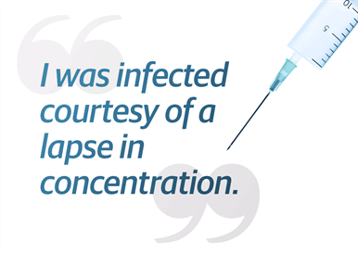
http://www.safeneedle.org/us-needlesticks/risk-of-injury/

Slide 35
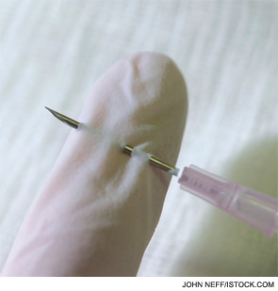
Needlestick injuries with contaminated needles can happen at any point of use including:
During device use
After device use,
but prior to disposal
During disposal
http://www.safeneedle.org/us-needlesticks/risk-of-injury/

Slide 36
Healthcare workers are at risk of injuries when:
Passing sharps between different individuals or to different locations
Recapping needles
Bumping into each other
Decontaminating or processing used equipment
Used sharps are not disposed of properly
Sharps are left in unusual locations such as stuck between mattresses, left on trays, or in pockets
http://www.safeneedle.org/us-needlesticks/risk-of-injury/

Slide 37
Needle Design Impacts The Risk of Injury
Devices with an increased risk of injury:
Hollow-bore needles
Devices that need to be taken apart or maneuvered by healthcare professional
Syringes retaining an exposed needle after being used
Needles attached to tubing
http://www.safeneedle.org/us-needlesticks/risk-of-injury/

Slide 38
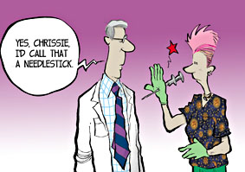
Nearly two-thirds of nurses report being accidentally stuck at some time in their career.
American Nurses Association Survey, 2008. https://www.nursingworld.org/~4ad48c/globalassets/docs/ana/inviro-fast-facts---6-17-2008.pdf

Slide 39
Things to Do IMMEDIATELY in Response to Needlestick Injury…
American Nurses Association Recommends that the healthcare worker should:
1) Provide care to exposure site by washing wound and skin with soap and water and flushing mucous membranes with water (for a blood splash or other potentially infectious material exposure incident).
2) Immediately seek evaluation and treatment for the injury from the emergency department or your employee health center…DO NOT WAIT until your shift is over or end of day!
3) Report the incident to your supervisor and document it according to employer policy, including the type and brand of device causing injury, department where injury occurred, and explanation of incident.

Slide 40
Things to Do in Response to Needlestick Injury - continued
4) Identify and document source patient (if known) who should be tested for HIV, hepatitis C and hepatitis B (depending on known immunity of healthcare worker). Hospital may have to seek consent.
5) Be tested immediately and confidentially for HIV and hepatitis B (if immunity uncertain or unknown) and C.
6) Get follow-up testing, counseling and monitoring of post-exposure prophylaxis toxicity.

Slide 41
Before initiating PEP First…If possible…determine if the source patient…
Is Infected with a Communicable Disease!
Taking a history
Performing a physical examination
Ordering appropriate laboratory testing
This can be accomplished by:
Source: American Family Physician, Voume 88, Number 1, July 1, 2013.

Slide 42
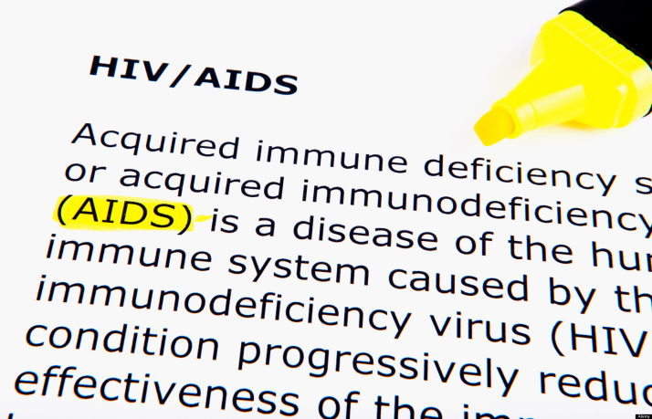
HIV PEP
Definition
needlestick or cut w/sharp object
contact of mucous membrane/non intact skin
prolonged contact w/intact skin
extensive area w/blood, tissue, or other body fluids
Exposure Risk
0.3%¹ Percutaneous blood
0.09%² Mucocutaneous blood
1. Bell DM. Am J Med 1997;102(suppl 5B):9--15.
2. Ippolito G et al. Arch Int Med 1993;153:1451--8.

Slide 43
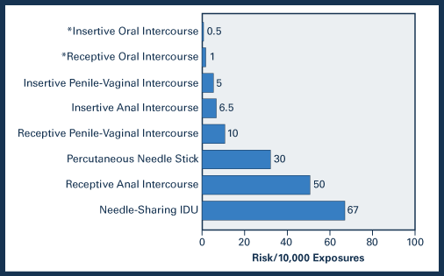
HIV: Risk of Infection
http://depts.washington.edu/hivaids/post/case5/discussion.html

Slide 44
Rationale of HIV PEP
Systemic infection does not occur immediately, leaving a short period of time during which PEP may reduce viral replication

Slide 45
Factors That Increase Risk
Exposure to a large quantity of blood
device visibly contaminated w/blood
needle placed directly into vein/artery
deep injury
Exposure to blood from patients with high viral loads or with advanced/end-stage AIDS

Slide 46
Estimated Per-Act Risk for Acquisition of HIV, by Exposure Route
Exposure Route | Risk per 10,000 exposures
Blood transfusion | 9,000
Needle-sharing injection drug use | 67
Receptive anal intercourse | 50
Percutaneous needle stick | 30
Receptive penile-vaginal intercourse | 10
Insertive anal intercourse | 6.5
Insertive penile-vaginal intercourse | 10
Receptive oral intercourse | 1
Insertive oral intercourse | 0.5
Notes:
Estimates of per-act risk of acquisition of HIV are approximate and vary widely depending on the viral load of the source contact, the presence of sexually transmitted diseases, and other factors.

Slide 47
HIV PEP – Critical Information!!
Therapy should be initiated as soon as possible - ideally within 1-2 hours after the exposure
Therapy may be altered if the source has known/suspected resistance to antiretroviral agents
HIV testing should be obtained for baseline

Slide 48
Post exposure prophylaxis: needle stick, sex
Assess time of exposure & risk:
Within 72 hours of exposure
Draw baseline HIV antibody test (would be negative if not previously infected)
Repeat in 6 wks
Repeat at 6 months

Slide 49
When Is HIV PEP Indicated
Is the Exposure from blood, bloody fluid,
or other potentially infectious
material or device?
No
No PEP indicated
Yes
PEP indicated

Slide 50
HIV PEP
“PEP is not justified for
exposures that pose a negligible
risk for transmission.”
Consultation with an expert can help determine if the exposure poses a “negligible risk” to explore whether alternative approaches, including a modified regimen, are appropriate.
http://nccc.ucsf.edu/wpcontent/uploads/2014/03/Updated_USPHS_Guidelines_Mgmt_ Occupational Exposures_HIV_Recommendations_PEP.pdf

Slide 51
HIV PEP: What to Give
Three-drug PEP regimens are now the recommended regimens for all exposures.
Guidelines no longer require assessing the degree of risk for the purpose of choosing a “basic” two-drug regimen vs. an “expanded” three-drug regimen.
There are some special circumstances, however, in which a two-drug regimen can be considered/used, especially when recommended antiretroviral medications are unavailable or there is concern about potential toxicity or adherence difficulties. In addition,
https://nccc.ucsf.edu/clinical-resources/pep-resources/pep-quick-guide/

Slide 52
PEP Regimen
Preferred HIV 3-Drug Occupational PEP Regimen:
Truvada™ 1 tablet by mouth once daily [co-formulated Tenofovir DF (Viread®; TDF) 300mg + emtricitabine (Emtriva™; FTC) 200mg] PLUS raltegravir (Isentress®; RAL) 400mg by mouth twice daily or dolutegravir (Tivicay™) 50mg PO once daily Duration: 28 days
https://nccc.ucsf.edu/clinical-resources/pep-resources/pep-quick-guide/

Slide 53
PEP Regimen
Alternative HIV Occupational PEP Regimens:
May combine one drug or drug pair from Column One with on pair of nucleoside/nucleotide reverse transcriptase inhibitors from Column Two
Column One |  | Column Two
Raltegravir (Isentress® ; RAL)
Dolutegravir (Tivicay™; DTG) |  | Tenofovir DF (Viread® ; TDF) + lamivudine (Epivir® ; 3TC)
Darunavir (Prezista® ; DRV) + ritonavir (Norvir® ; RTV) |  | Zidovudine (Retrovir™ ; ZDV; AZT) + lamivudine (Epivir® ; 3TC); available co-formulated as Combivir®
Atazanavir (Reyataz® ; ATV) + ritonavir (Norvir® ; RTV) |  | Zidovudine (Retrovir™ ; ZDV ; AZT) + emtrictabine (Emtriva™ ; FTC)
Lopinavir/ritonavir (Kaletra® ; LPV/RTV)
Etravirine (Intelence® ; ETR)
Rilpivirine (Edurant™ ; RPV)
https://nccc.ucsf.edu/clinical-resources/pep-resources/pep-quick-guide/

Slide 54
P₃
Linking people to Care

Slide 55
https://www.cdc.gov/hiv/pdf/library/factsheets/cdc-hiv-care-continuum.pdf

Slide 56
The 90 – 90 – 90 Targets for 2020
http://www.unaids.org/sites/default/files/media_asset/Global_AIDS_update_2017_en.pdf
Notes:
The data show that substantial progress has been made towards the 90–90–90 targets. More than two thirds of all people living with HIV globally knew their HIV status in 2016. Among those who knew their HIV status, 77% [57– >89%] were accessing antiretroviral therapy, and 82% [60– >89%] of people on treatment had suppressed viral loads. Amid this progress, a major milestone was reached in 2016: for the first time, more than half of all people living with HIV (53% [39–65%]) were accessing antiretroviral therapy.

Slide 57
Most Women Diagnosed with HIV Not Linked to Care
More than half of women surveyed in the US and its territories who tested positive for HIV in 2015 had received a diagnosis in the past; however, most were not linked to care.
Stein R, et al. MMWR Morb Mortal Wkly Rep. 2017.doi;10.15585/mmwr.mm6641a2

Slide 58
Time From HIV Infection to Diagnosis is Cut 17% in US
The average time between HIV infection and diagnosis decreased 17% in the United States from 3 years and 7 months in 2011 to 3 years in 2015, according to data released by the CDC.

